Slide 1
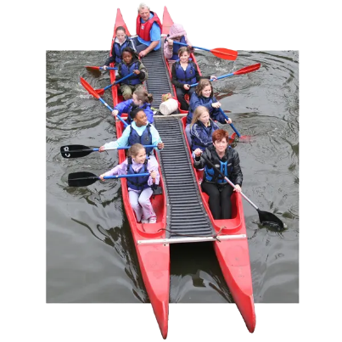
Our River Avon Adventure
Getting ready for bell boating in Stratford-upon-Avon
Be alert • Be a team • Be water-wise
1

Slide 2
PSHE: Discuss river safety for bell boating trip
Recognise river hazards
and make safe choices
Know what a bell boat is
and how teamwork helps
Remember school-trip
behaviour expectations
Know exactly what to
wear and bring
2

Slide 3
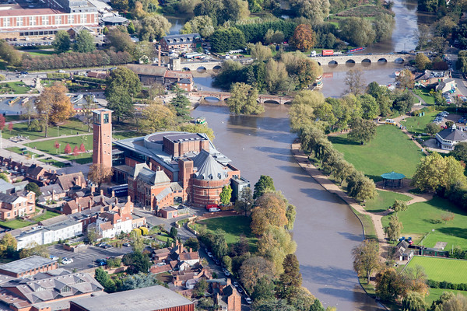
First thoughts: what can you spot?
Think–pair–share: What could make a riverside safe or unsafe?
Slippery banks?
Moving water?
Other boats?
Weirs / locks?
Notice → think → act safely
3

Slide 4
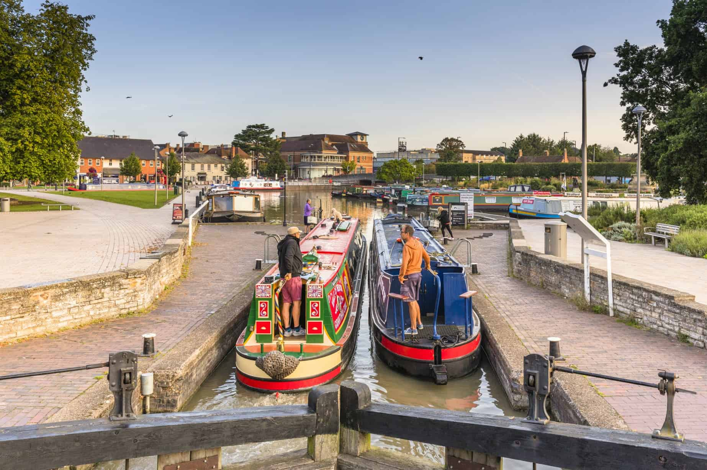
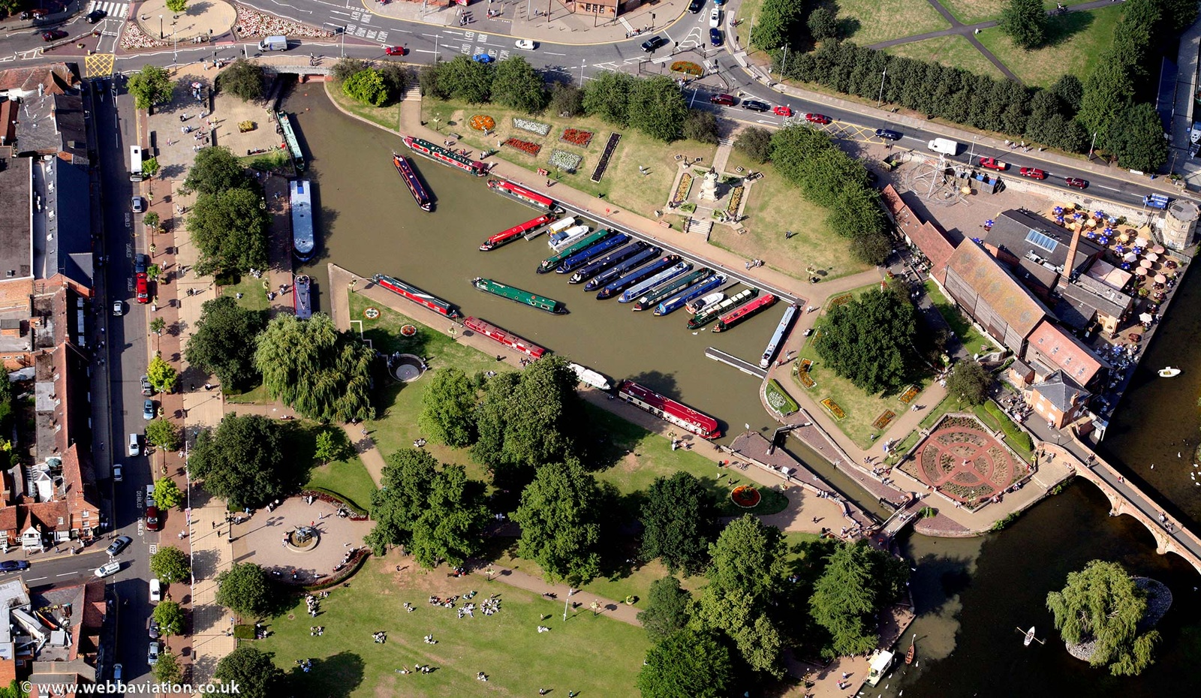
Meet the River Avon at Stratford
Stratford-upon-Avon Canal
Bancroft Basin
River Avon
The Stratford-upon-Avon Canal reaches the River Avon at Bancroft Basin, beside the theatre.
The canal was built to connect Stratford and the Avon with the Midlands canal network.
The Avon river is part of a working, navigable waterway: you may see boat trips, rowing boats, narrowboats and other paddlers.
Because it is a real waterway, we must be alert and keep clear of hazards and other craft.
4

Slide 5
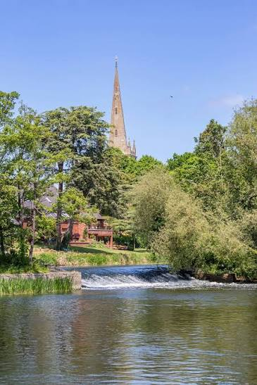
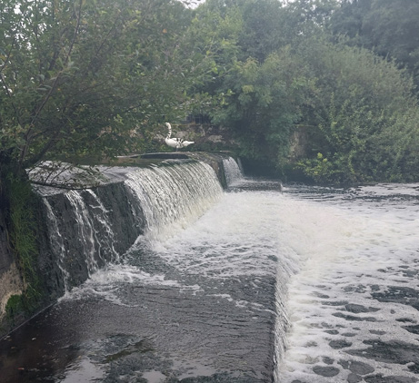
What is a weir — and why keep away?
A weir is a low barrier across a river that changes the water level and flow.
Lucy’s Mill has weirs and a navigation lock.
Water near a weir can move strongly and unpredictably.
On our trip: follow the instructor and stay well clear of weirs.
Important: our exact route is decided by the qualified activity leader and conditions on the day.
5

Slide 6
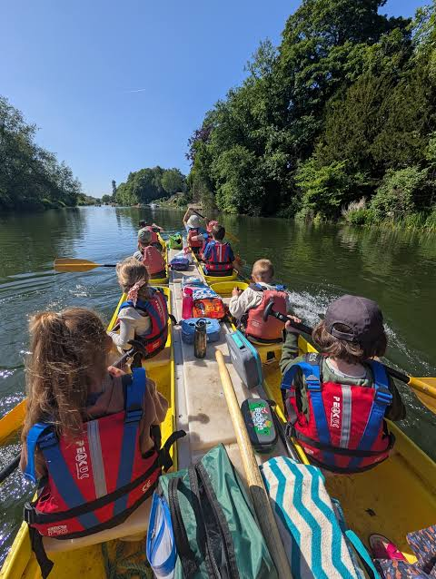
What is bell boating?
A bell boat is a twin-hulled open canoe: two long canoe-like hulls joined by a platform.
The crew uses single-bladed paddles and works together to move smoothly.
Bell boats are especially useful for beginners because they are stable and encourage teamwork.
Bell boats can hold up to 10 adults.
Teamwork challenge: can everyone paddle in rhythm?
6

Slide 7
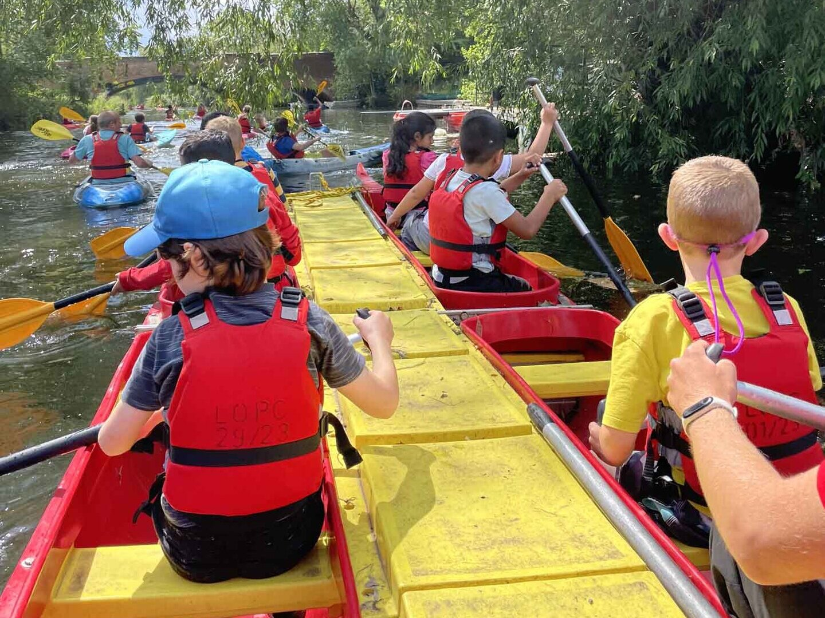
On the boat: the teamwork code
The safest crew is a listening crew.
Listen to the instructor and the adult on your boat.
Buoyancy aids will be provided.
Keep your buoyancy aid on and correctly fastened.
Stay seated unless the instructor tells you otherwise.
Keep hands, feet, bags and paddles where instructed.
Paddle together; stop immediately when asked.
Tell an adult straight away if you feel worried or unwell.
7

Slide 8
River safety: have you got their back?
Never dare, pressure or encourage someone to take a risk near water.
Banks, rocks and paths can be slippery near water.
The depth and current of a river is hard to judge.
Cold water can affect the body quickly, even when the weather feels warm.
Helpful words:
“No — let’s stay with the group.”
Helpful words:
“That’s not safe. I’m telling an adult.”
Helpful words:
“Come back from the edge with me.”
If something feels unsafe, say so and move to a safer place with an adult.
8

Slide 9
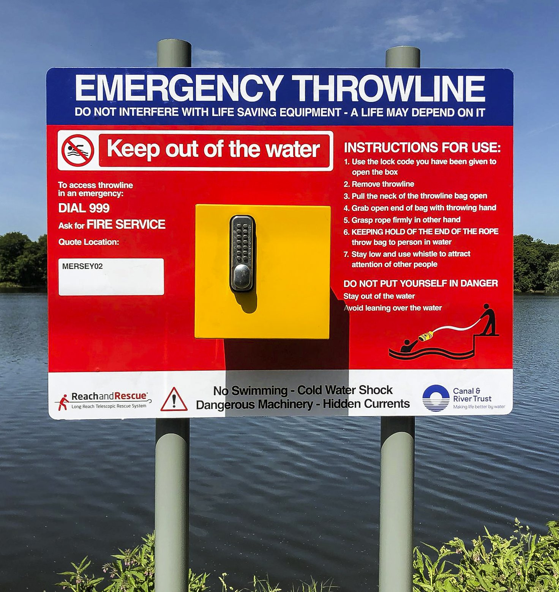
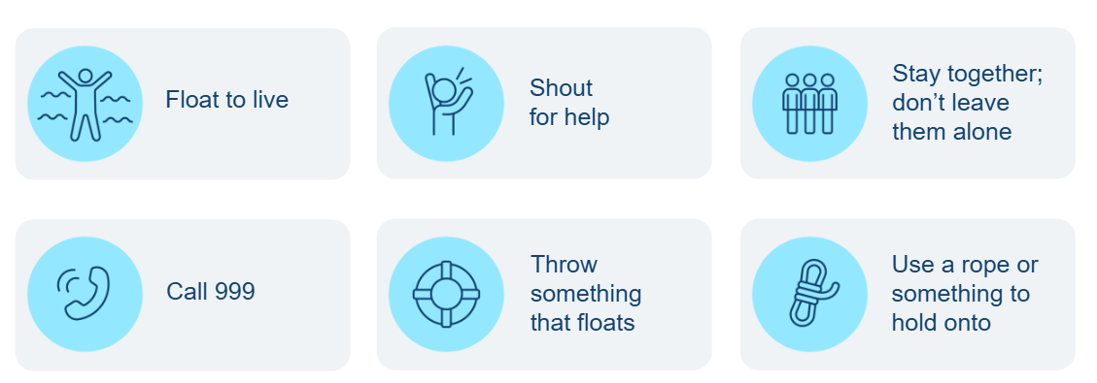
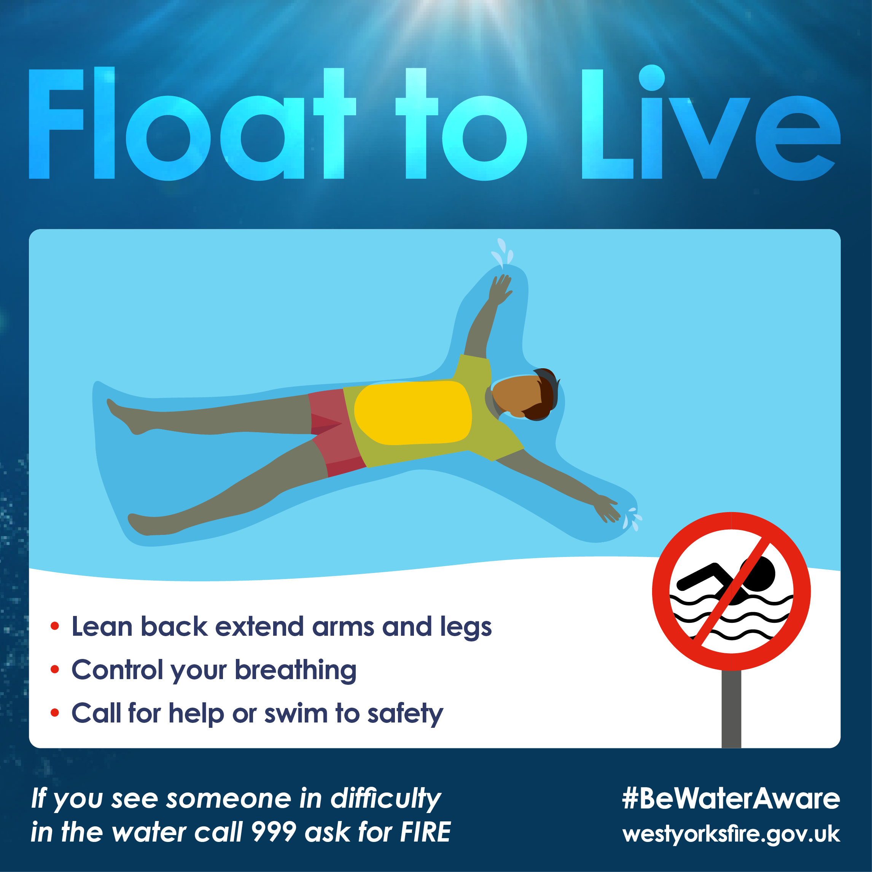
If someone gets into trouble in the water…
1
4
2
5
3
9

Slide 10
If someone gets into trouble in the water…
1
4
2
5
3
9

Slide 11
If someone gets into trouble in the water
1 SHOUT
Call for an
adult / help
4 STAY
Keep watching from safety - do not enter the water to rescue them.
2 CALL 999
Ask for Fire &
Rescue
5 FLOAT TO LIVE
If you are in trouble
3 THROW
Something that floats, if safe
9

Slide 12
School-trip behaviour: our expectations
We represent our school wherever we go.
Stay with your group
Never wander off; move when your accompanying adult tells you.
First-time listening
Stop, look and listen immediately for instructions.
Respect everyone
Use kind words; include others; no pushing, splashing or dares.
Respect the place
Leave wildlife, boats and equipment alone unless invited to use them.
Make safe choices
Pay attention to paths, keep back from edges and follow boundaries.
Speak up
Tell an adult if you are worried, uncomfortable or notice a hazard.
10

Slide 13
What to wear
Prepare for changing weather — and for getting a little wet.
Plenty of layers. For example: T-shirt, sweatshirt / fleece and joggers.
Trainers or other sensible shoes.
Waterproof jacket. Waterproof trousers too if you have them (helpful, but not essential).
For sunny weather: sun hat and suntan lotion.
NO JEANS
NO WELLIES
Buoyancy aids
are provided
11

Slide 14
Two bags — pack them differently
BAG 1 — stays with spare kit
• Spare clothes/shoes
• Towel
Put these together in ONE bag.
BAG 2 — comes on the boat
• Substantial morning snack
• Lunch
• Filled water bottle
Use a carrier bag or small rucksack.
This makes the day easier and keeps boat essentials together.
12

Slide 15
Scenario challenge
In pairs: agree on the safest response and explain why.
Scenario A: A friend wants to race or play-fight beside the river.
Scenario B: Someone dares another child to splash someone else.
Scenario C: You notice the weather changing and feel cold.
Scenario D: You see fast-moving water near a barrier or weir.
Sentence stem: “The safest choice is… because…”
13

Slide 16
Scenario challenge
In pairs: agree on the safest response and explain why.
Scenario A: A friend wants to race or play-fight beside the river.
Scenario B: Someone dares another child to splash someone else.
Scenario C: You notice the weather changing and feel cold.
Scenario D: You see fast-moving water near a barrier or weir.
Sentence stem: “The safest choice is… because…”
13

Slide 17
Scenario challenge
In pairs: agree on the safest response and explain why.
Scenario A: A friend wants to race or play-fight beside the river.
Scenario B: Someone dares another child to splash someone else.
Scenario C: You notice the weather changing and feel cold.
Scenario D: You see fast-moving water near a barrier or weir.
Sentence stem: “The safest choice is… because…”
13

Slide 18
Ready-check quiz
Show thumbs up when you can answer each one.
What is a bell boat?
Why do we keep away from weirs?
What should you do if the instructor says “STOP”?
Name two things you must NOT wear for bell boating.
What goes in the separate boat bag?
How can you ‘have someone’s back’ near water?
14

Slide 19
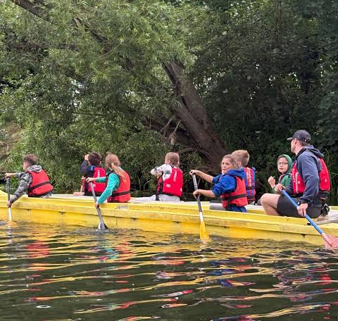
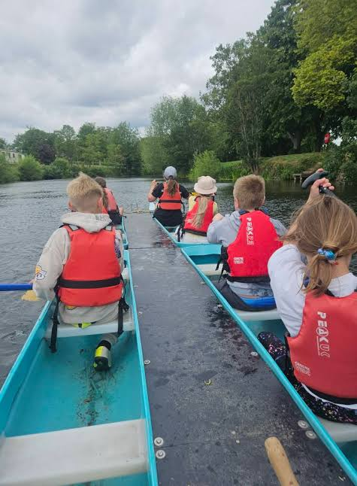
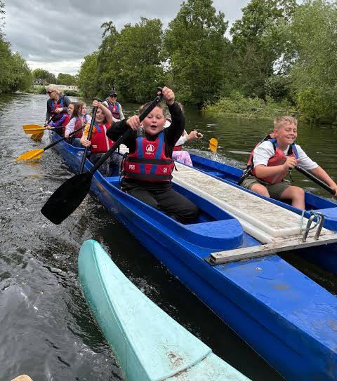
We’re ready for the Avon!!
Safe choices + teamwork + listening = a brilliant day
Final promise: I will follow instructions, look after my team and respect the river.
15

Slide 20
Teacher notes & sources
• Original resource: Canal & River Trust ‘Have you got their back?’ water-safety presentation supplied by the school.
• Local geography: Canal & River Trust information on the South Stratford Canal and Bancroft Basin; Avon Navigation Trust information on the navigable Avon.
• Lucy’s Mill: Stratford local-history / council material confirms weirs and a navigation lock downstream of the town centre.
• Bell boating: Scouts / Girlguiding guidance describes a stable twin-hulled open canoe, paddled as a team and controlled by a helm.
• Exact route, river conditions, equipment and operational instructions must always come from the school and qualified activity provider on the day.
16

