Slide 1


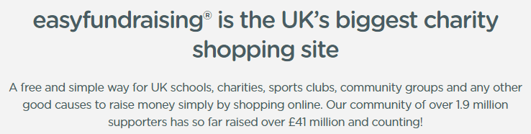
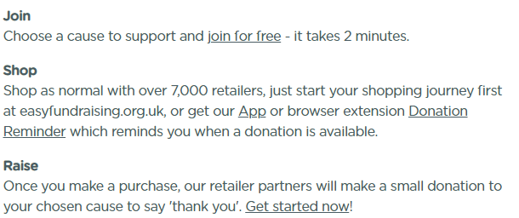
Did you know you can support FOBS every time you shop online?
Friends of Bridgetown School
Income and Expenditure
2022/2023
FOBS were so pleased to be able to offer a normal year of activities for the local community during 2022 and 2023

Slide 2
Donations & Grants
£3,667
Events
£11,689
Expenditure
£20,550
Co-op | £3,337
Amazon Smile | £427
Warwickshire CC | £148
Benevity | 101
Warwickshire Xmas Trees | £81
Easy Fundraising | £75
IBM | £62
Terracycle | £37
Heart of England Community Fund * | (£601)
Panto | £3,014
Christmas Fair | £2,735
Summer Fair | £2,333
Discos x2 | £1,112
Bingo | £864
Frozen Fridays / Crisps / Sweets sales | £416
Bridgetown’s Got Talent | £275
Christmas Cards | £257
Scarecrow Trail | £202
Tea Towels & Coasters | £197
Grandparents’ Day | £153
Swan food | £72
Uniform Sales | £60
Solar Panels | £10,000
Yr1 Outside Area | £4,000
Library | £2,029
Theatre Trips | £1,986
Water Coolers | £545
Yr6 Hoodies | £441
Coronation Bookmarks | £368
FOBS Running Costs | £360
Reception Big School Books | £306
Author Visits | £198
Maths Equipment | £148
Film Licence | £119
Christmas Tree | £50
* Funding from previous year returned due to underspend

Slide 3
Autumn Term
Winter Term
Summer Term
Stay & Play | Sept
Inflatables* | Oct 14th
Disco | Oct 20th
Scarecrow Trail | Oct ½ term
Christmas Fair | Dec 1st
Panto | Feb 2 & 3
Disco | Mar 8
Bingo | April 19
Quiz | May 17
AGM & Event | June TBC
Summer Fair | July 13th
Uniform Sales
Sweet / Crisps Sales
Grandparents Picnic
Multi-school sports day
Frozen Fridays
Uniform Sales
Swan Food Sales over Summer
**TBC - Coop Community Charity - start in October 2024
Warwickshire Christmas Trees
Ongoing:
  Easyfundraising
  IBM
  Espo & My School (school voucher)
  Warwickshire CC applications (will get 1 of 2)

Slide 4
Inflatables as an option!
12:45 to 13:30 start time for our charity - we can set up a small table & be there to cheer on. Minimum age is 5 for doing the race.
for bulk buying places during the sale - currently assuming less than 10 (further discount the more we buy)
2.5k - Adult £25 / Child £15
5k - Adult £29 / Child £19
10k Adult £39 / Child £29
15k - Adult £49 / Child £39
Need payment 4 weeks before the event
At the finish everyone gets a medal, running socks and multifunctional headscarf.

