Slide 1
Year 2

Slide 2
Overview
Activity | Individual activity | Pairs activity | Small group activity | Whole class activity | Resources needed
1) Twos Tennis |  | x
2) Take the Twos |  | x |  |  | Resource 1 per pair
3) Bingo |  |  |  | x | Mini whiteboards
4) Feisty Forty-Five |  |  |  | x | Mini whiteboards
5) Fishy Fives |  |  |  | x
6) Ready for Take Off? |  |  | x
7) Roll for Tens |  | x |  |  | 12-sided dice per pair
8) Tens Meet in the Middle |  |  |  | x | Resource 2 An area
9) Race the Tens |  | x |  | x | Resource 3 An area

Slide 3
Overview
Activity | Individual activity | Pairs activity | Small group activity | Whole class activity | Resources needed
10) Picture Perfect |  | x |  |  | Paper Coloured pens
11) Amazing Arrays |  | x |  |  | Counters
12) Fizz Buzz |  |  |  | x
13) Four in a Row |  | x |  |  | Resource 4 per pair Counters
14) Multiplication in the Wild |  |  | x |  | (If available) cameras
15) Escape to the Moon |  | x |  |  | Resource 5 per pair 6-sided die per pair Counter each
16) Multiples on the Run |  |  |  | x | A large area

Slide 4
Twos Tennis
Pairs
Focus: Counting forwards and backwards in and recognising multiples of 2.
Aim: Count forwards and backwards in twos without making a mistake.
Instructions:
In pairs, you are going to play tennis using multiples of 2 instead of a ball.
One person will start by saying 0, the next person will say the next multiple of 2. Take it in turns until you reach 24 without mistakes.
When you reach 24, you have to count backwards in multiples of 2 to 0.
If you make a mistake or take more than 3 seconds to answer, your partner wins a point.
Notes:
Key questions:
How do you know your partner has said the correct answer?
What do you notice about the numbers we say when we count in twos?
Do we say the same numbers when counting backwards as forwards?
Extension:
Play the game with other multiples e.g. multiples of 5 or 10.

Slide 5
Take the Twos
Pairs
Focus: Recognising multiplication facts from the 2 times tables.
Aim: Win the most cards by saying a multiplication calculation that gives the answer on the card.
You will need: Resource 1 per pair
Instructions:
In pairs you will need a set of cards.
Take it in turns to turn over a card.
Both of you need to try to be the first to say aloud the two times table multiplication fact for the number shown.
If you say the fact first, you win the card.
The person with the most cards when all the cards are gone wins.
Example
10 is turned over.
A says 4 × 2 = 10.
B says 5 × 2 = 10.
B wins the card because they said the correct fact, even though they weren’t first to answer.
Notes:
Key questions:
Is there more than one multiplication fact for this number?
How can you check your answer and your partner’s answer?
Which number is the easiest to turn over? Why?
Extension:
Say a multiplication fact then all the related multiplication and division facts for that calculation.

Slide 6
Bingo
Whole class
Focus: Related division facts for the two times tables.
Aim: Be the first to cross off all your numbers.
You will need: Mini whiteboards
Instructions:
Write down four different numbers between 1 and 12.
Your teacher will say a division question from the two times tables.
If one of your numbers is the answer to the question, cross it off.
When all four of your numbers have been crossed off, shout ‘bingo’.
Example
I write down 1, 2, 5, 7 and 8.
My teacher says, “10 divided by 2 equals …” so I cross off 5.
When I have crossed off all my numbers, I shout, “Bingo!”
Notes:
Key questions:
How do you know this is a division question? Which multiplication fact could you use to help you?
Extension:
Use the 2, 5 and / or 10 times tables.

Slide 7
Feisty Forty-Five
Whole class
Focus: Counting in and recognising multiples of 5.
Aim: Predict who will be the next person to say 45 when counting in multiples of 5.
You will need: Mini whiteboards
Instructions:
The whole class (and teacher) need to stand in a circle with a whiteboard and pen.
Your teacher will start by saying 0. Going round the circle, count in multiples of 5 to 70 then count backwards from 70 to 0.
Whoever has to say 45 must sit down. Everyone then predicts who will be the next person to sit down and write this on their whiteboard. Keep a note of how many right answers you get.
There are two ways to win: a) If you are the last person standing. b) If you had the most correct predictions of who will be out.
Notes:
Key questions:
Which number will you say next? What do you notice about multiples of 5?
How can you work out who will be out next?
Extension:
Change the feisty number from 45 to another number.

Slide 8
Fishy Fives
Whole class
Focus: Count in and recognise multiples of 5.
Aim: Say ‘fish’ instead of any multiple of 5.
Instructions:
Together we are going to count in ones from 1 to 60.
Every time we say a multiple of 5, we say ‘fish’ instead of the number.
Example
1
2
3
4
FISH
6
7
8
9
FISH
Notes:
Key questions:
What do you notice about the numbers we are replacing?
Would we say fish more or less if we were replacing multiples of 2 or 10 with ‘fish’? Why?
Extension:
Count beyond 60 or use one of the variations.

Slide 9
Ready for Take Off?
Small group
Focus: Counting backwards in multiples of 5.
Aim: Count backwards from 70 to 0 in multiples of 5 without two people talking at the same time.
Instructions:
Your teacher will put you in groups of 7 to 12.
Sit in a circle with your group.
You are going to count from 70 to 0 in multiples of 5. When you get to 0 you all need to shout, “Take off!” as your rocket has launched!
Only one of you can speak at a time.
If two people speak at the same time you need to start from 70 again.
Example
A: 70
B: 65
C and D: 60
The group need to start again.
Notes:
Key questions:
What do you notice about the numbers you are saying?
Would it be easier to do this in reverse (counting forwards not backwards)? Why?
Would you say [number]? Why / why not?
Do you have a strategy you could use to avoid mistakes?
Extension:
As a group develop strategies (e.g. count in a circle, hold up your hand before speaking) that could be used. Which strategy is the best? Why?

Slide 10
Roll for Tens
Pairs
Focus: Fluency in the 10 times tables.
Aim: Be the first person to say the correct answer.
You will need: 12- sided dice per pair
Instructions:
In pairs, you will need one 12-sided die each.
Roll the die then race against each other to multiply the number shown by 10.
The first person to say the whole calculation correctly wins.
The winner is the first person to get to 20 points.
Example
Roll the 12-sided die.
It shows 9.
Partner A says, “9 × 10 = 90” first.
Partner A gets one point.
Notes:
Key questions:
What do you notice about all the answers?
How can you find the answer quicker?
Can you think of another fact linked to the one you gave?
What multiple of 10 cannot be rolled when using two 6-sided dice? (10)
Extension:
If the answer is less than 100, pupils can write the number bond to 100 of their answer E.g. 40 and 60, 70 and 30. If their number bond is correct, they get a bonus point.

Slide 11
Tens Meet in the Middle
Whole class
Focus: Fluency and recall of multiplication and division facts for the ten times tables.
Aim: Say a ten times table multiplication or division fact for the number your partner has.
You will need: Resource 2; An area
Instructions:
Your teacher will give you a card.
When they say so, walk around the space. When they say ‘meet’, find a partner.
Look at your partner’s card. You need to say one multiplication or division fact from the ten times table that is linked to the number your partner has.
When you have both said a calculation, swap cards.
Find another partner and do the same again.
Notes:
Key questions:
Is there another fact you could have given?
Is there a division fact you could say?
Extension:
Give all the related facts before moving on.

Slide 12
Race the Tens
Pairs/ Whole class
Focus: Multiplication facts for the 10 times tables.
Aim: Select the card with the answer to the given question and take it to the other side of the room.
You will need: Resource 3 per pair; an area
Instructions:
In pairs, you’ll need one set of cards.
Your teacher will say a multiplication calculation. You and your partner need to find the correct answer and race to put it on the other side of the room.
Notes:
Key questions:
Which multiplication could I call out that would have the same answer?
Which multiplication fact do I need to say to get one of your remaining cards to the other side of the room?
Which division fact is linked to this multiplication fact?
Extension:
Pupils to give all the related facts for the given calculation.

Slide 13

Picture Perfect
Pairs
Focus: Identify and use multiplication facts for the 2, 5 and 10 times tables.
Aim: Draw your secret fact clearly.
Instructions:
Which multiplication fact does this picture show?
In partners, you will each pick a ‘secret’ multiplication fact from the 2, 5 or 10 times tables. Draw a picture that shows your secret fact.
When you’ve finished, swap pictures and work out the secret fact your partner has drawn.
If you can’t guess the secret fact, your partner needs to explain what they drew and why.
Notes:
Key questions:
How can you work out which multiplication fact is represented?
Could the image show more than one multiplication fact?
Can you say the related division facts?
Extension:
Add a focus, for example: draw your secret fact using groups.

Slide 14
Amazing Arrays
Pairs
Focus: Identify and use multiplication facts for the 2, 5 and 10 times tables.
Aim: Arrange counters in arrays.
You will need: Counters
Instructions:
One partner picks up a handful of counters and guesses how many they have.
The second partner then puts the counters into an array of 2s, 5s or 10s. If the counters aren’t a multiple of 2, 5 or 10, arrange them into an array for the 1 times table (a single line).
The first partner then says what the array shows.
Example
Partner A pick up counters and says, “I think there are 15 counters.”
Partner B puts the counters into an array showing 7 columns and 2 rows.
Partner A says, “The array shows 7 × 2 = 14 so there are 14 counters.”
Notes:
Key questions:
Are there any other arrays you could make from these counters?
Why can’t this number be arranged into a different array?
Which division facts can be shown by this array?
Extension:
Which numbers need to be represented by a single line?

Slide 15
Fizz and Buzz
Whole class
Focus: Identify multiples of 5 and 10.
Aim: Don’t say multiples of 5 or 10.
Instructions:
Count in ones from 0. When you are supposed to say a multiple of 5, say fizz instead.
Next, count in ones again, this time when you are supposed to say a multiple of 10, say buzz instead.
Finally, combine these two rules. When you should say a multiple of 5 say fizz, when you should say a multiple of 10 say buzz. If a number is a multiple of 5 and 10, say fizz-buzz.
Example
1
2
3
4
FIZZ
6
7
8
9
FIZZ-BUZZ
Notes:
Key questions:
What do you notice about the numbers that you are replacing with fizz and buzz?
Why is buzz never said on its own?
Which do we say more often, fizz or buzz?
Extension:
Add ‘pop’ instead of a multiple of 2.

Slide 16
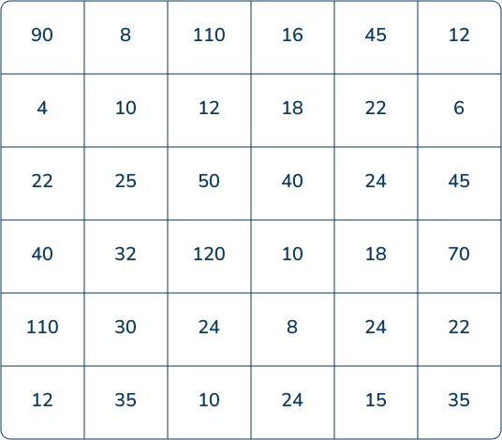
Four in a Row
Pairs
Focus: Recognising and using the 2, 5 and 10 times table and related division facts.
Aim: Put four counters in a row.
You will need: Resource 4 per pair; counters
Instructions:
To place a counter, you need to point to a number and say a multiplication fact that involves the number you have pointed to. You cannot use the one times table.
If your fact is correct, you can place your counter.
If your fact is incorrect, you can’t place your counter.
The person who first makes a row of four is the winner.
Notes:
Key questions:
How do you know the fact given is correct?
Is there more than one multiplication fact you could give?
Is there any number where you could only give one fact?
Which number is the easiest / hardest to cover? Why?
Extension:
Say two multiplication facts for the number you want to cover.

Slide 17
Multiplication in the Wild
Small groups
Focus: Multiplication and division facts for the 2, 5 and 10 times tables.
Aim: Find representations of the 2, 5 or 10 times tables around the school.
You will need: If available, cameras
Instructions:
In small groups, explore the school to spot things that represent multiplication and division facts for the 2, 5 and 10 times tables.
When you find something, take a photo or make a note of it. Can you write all the multiplication and division facts for what you have found?
Notes:
Key questions:
Is there any times table that is easier to spot?
Does one picture show more than one fact? Why / why not?
Extension:
Set a total number of representations they need to find (for example, find 30 representations).

Slide 18
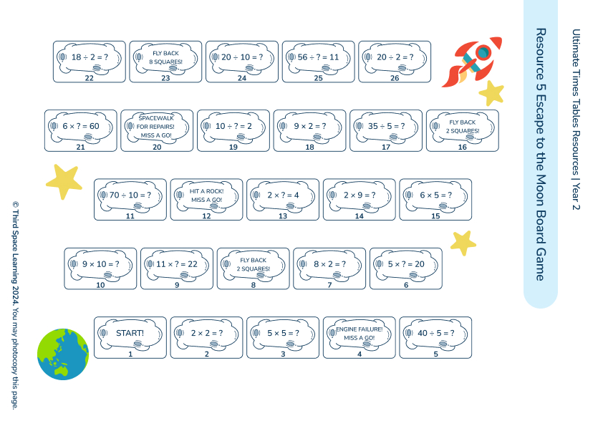
Escape to the Moon
Pairs
Focus: The 2, 5 and 10 times tables and related division facts.
Aim: Land on the moon first.
You will need: Resource 5 per pair; one 6-sided die per pair
Instructions:
In pairs, you will get a race to the moon sheet, a 6-sided die and a counter each.
You need to roll the die and move the number of spaces rolled. Read and answer the question on the square or follow the instructions.
The first person to land on the moon wins.
Notes:
Key questions:
How can you check your answer is correct?
Can you draw a picture to help you show the calculation?
Is there another fact linked to the fact you landed on?
Extension:
Give a related fact to the fact on the square you have landed on.

Slide 19
Multiples on the Run
Whole class
Focus: Recognise and use multiples of 2, 5 and 10.
Aim: Earn your team points by knowing if a number is a multiple of 2, 5 or 10.
You will need: A large area
Instructions:
Your teacher will put you into groups and say if your group is 2, 5 or 10.
Your teacher will then call out a number. If the number is a multiple of your group number, run to the other side of the room.
If you’re first and correct, you win your team a point. The first team to 20 points wins.
Example
The teacher says, “14”.
All of the twos group should run to the other side of the room as 7 × 2 = 14.
The teacher says, “20”.
All groups should run to the other side of the room as 10 × 2 = 20, 4 × 5 = 20 and 2 × 10 = 20.
Notes:
Key questions:
How can you prove that the number is a multiple of your group number?
Are there any other facts that help prove your number is a multiple of your group number?
Which number would make all the groups run?
Extension:
Ask pupils to identify all the facts to prove the number is a multiple of their number.

