Slide 1
Year 5

Slide 2
Overview
Activity | Individual activity | Pairs activity | Small group activity | Whole class activity | Resources needed
1) Divided Race |  |  |  | x | Resource 1 An area
2) Dice Duel |  | x |  |  | 12-sided dice per pupil
3) Maths, Paper, Scissors |  | x
4) Question Race | x |  |  |  | Mini whiteboards
5) Marathon Race |  | x |  |  | Resource 2 6-sided dice Counters
6) Links and More Links |  |  | x
7) Aliens Have Landed | x |  |  |  | Resource 3
8) Bingo |  |  |  | x | Mini whiteboards

Slide 3
Overview
Activity | Individual activity | Pairs activity | Small group activity | Whole class activity | Resources needed
9) Back to Ten |  |  | x |  | Mini whiteboards
10) Who has the Maths Factor? |  |  | x | x | Mini whiteboards
11) Spin and Pop |  |  |  | x
12) Meet in the Middle |  |  |  | x | Resource 4 An area Mini whiteboards
13) What do we know? |  |  |  | x | Mini whiteboards
14) Race the Answer |  |  |  | x | Two copies of resource 5 A large area
15) Looping facts |  |  |  | x | Resource 6
16) Multiples Five in a Row |  | x |  |  | Resource 7 Different colour counters

Slide 4
Divided Race
Whole class
Focus: Recall multiplication and division facts for the 1 - 12 times tables.
Aim: Run to the answer of the given question.
You will need: Resource 1; an area to play the game
Instructions:
Stand in the middle of the room.
Your teacher will call out a division question linked to the 1 to 12 times tables.
Run to the number around the room that would be the answer to the question.
Example
Teacher says, “24 ÷ 12 equals…”
Children should all run to the number 2.
Notes:
Key questions:
Can you explain your strategy for finding the answer?
Can you think of another fact linked to this one?
Extension:
Include some division facts.

Slide 5
Dice Duel
Pairs
Focus: Recall multiplication and related division facts for the 1 to 12 times tables and facts linked by multiples for 10.
Aim: Be the first person to multiply the two numbers together.
You will need: 12-sided dice each
Instructions:
Each person in the pair needs to roll their dice.
Race against each other to multiply the two numbers on the dice together.
The first person to say the full calculation out loud correctly wins one point (e.g. 5 × 9 = 45).
The first person to get 20 points wins.
Notes:
Key questions:
How have you calculated the answer?
Which key multiplication facts are you using to help you?
Extension:
Say a related division fact.
Roll the two 12-sided dice then roll an extra 6-sided die. Multiply the first product by the number on the 6-sided die.

Slide 6
Maths, Paper, Scissors
Pairs
Focus: Recognise and use multiplication and division facts for the 2, 3, 4, 5, 8 and 10 times tables.
Aim: Play a maths version of rock, paper, scissors.
Instructions:
Make both hands into fists and say maths, paper, scissors.
When you get to scissors, hold out between 2 and 10 fingers.
Multiply the number of fingers you hold up by the number of fingers your partner holds up.
The first person to say the correct calculation and answer wins a point.
The winner is the person to get 20 points.
Example
“Maths, paper, scissor!”
Partner A holds out 3 fingers.
Partner B holds out 4 fingers.
Partner A says, “3 × 4 = 12” first and wins a point.
Notes:
Key questions:
Why have we said you can’t show 1 or 0 fingers?
What is the largest possible answer based on the number of fingers you could put out?
Extension:
Play a round of maths, paper, scissors. The winner of two games play each other. The pupils who didn’t win become cheerleaders. This will result in two pupils battling to be the ultimate winner.

Slide 7
Question Race
Individual
Focus: Recognise and use multiplication and division facts for the 2 to 12 times tables.
Aim: Find as many multiplication and division facts for the number given.
You will need: Mini whiteboards
Instructions:
Your teacher is going to write a number on the board. You need to write as many multiplication and division statements that involve the number they have written in the time given.
Compare the statements you have written with someone else; did they find any that you didn’t?
Notes:
Key questions:
Which times table is this number in?
Extension:
Include numbers that are multiples of 10 or 100.

Slide 8
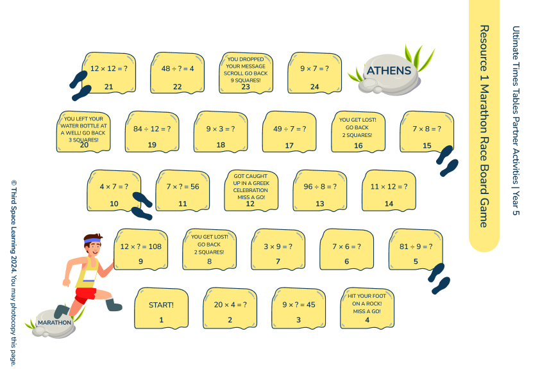
Marathon Race
Pairs
Focus: The 1 to 12 times tables and related division facts.
Aim: Land on Athens first.
You will need: Resource 2; 6-sided dice; counters
Instructions:
In pairs, you will need a ‘Marathon race’ game board, a 6-sided dice and a counter each.
Roll the dice and move that number of spaces.
Answer the question on the space or follow the instructions. If you answer a question incorrectly, you must return to the square you came from.
To win, you must land on Athens.
Notes:
Key questions:
How can you check your partner’s answers?
Which facts do you find easier to recall? Why?
Which facts can you use to recall other facts?
Extension:
Give one related fact for the question you land on.

Slide 9
Links and More Links
Small group
Focus: Investigate and explore links between the 1 to 12 times tables.
Aim: Explore the links between the different times tables.
Instructions:
Evie say, “I know my 4 times table is linked to my 8 times table.”
In small groups, discuss what Evie has said. Do you agree? Can you prove your ideas?
How are other times tables linked? In your groups, identify and explain the links you know of.
Notes:
Key questions:
Which tables are linked? How do you know? Explain the links.
How can you use these links to help you solve harder times table questions?
Which times table has the most links?
Extension:
Explore the links between multiplying multiples of 10 and the 1 to 12 times tables.

Slide 10
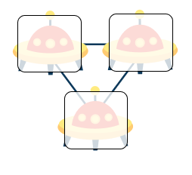
Aliens Have Landed
Individual
Focus: Recognise and use multiplication and division facts for the 1 to 12 times tables, including facts related by a power of 10.
Aim: Create tripods and write all the related facts.
You will need: Resource 3
Instructions:
Look at the alien tripod.
What do you think the link is between the numbers in the spaceship? Which multiplication or division facts could you write using these numbers?
Using the Alien Tripods worksheet, create 9 different tripods. Each tripod must contain a multiple of ten.
In the box underneath each tripod, write the calculations that can be made using the numbers you have written.
30
4
120
Notes:
Key questions:
Which multiple of 10 will you use?
How can you use your knowledge of the 1 to 12 times tables to help you?
Extension:
Create a tripod where the multiplier and multiplicand are both multiples of 10.

Slide 11
Bingo
Whole class
Focus: Related division facts for the 1 to 12 times tables and facts linked through powers of 10 and 100.
Aim: Be the first to cross off all your bingo numbers.
You will need: Mini whiteboards
Instructions:
Write down five different numbers between 1 and 12. These are your bingo numbers.
Your teacher will call out a division question that involves two multiples of 10 or 100 and is linked to the 1 to 12 times table (for example 360 ÷ 60).
If one of your bingo numbers is the answer to the question, cross it off.
When you cross off all your numbers, shout ‘bingo’.
Notes:
Key questions:
What question could I ask that would give one of your numbers?
Is there more than one question I could ask that would give the answer of [number]?
Extension:
Pupils could play this game in small groups with one person being the ‘caller’.

Slide 12
Back to Ten
Small group
Focus: Recall of multiplication and related division facts for the 1 to 12 times tables and facts linked by multiples of 10 or 100.
Aim: Calculate the missing number written by a partner.
You will need: Mini whiteboards
Instructions:
In groups of three, label yourselves A, B and C.
A and B will stand back-to-back. C will be the ‘spotter’.
A will write down a multiple of 10 or 100, B will write down a number between 1 and 12.
C will look at the numbers and say the product only.
A and B will race to calculate the other person’s number. Whoever works out the other person’s number first wins a point. Rotate the roles after each turn.
Example
C is the spotter.
A and B stand back-to-back.
A writes 20.
B writes 3.
C looks at both numbers and says, “60”.
A works out that 20 × 3 = 60 and says, “3”.
Notes:
Key questions:
How can you work out the missing number? Which facts can you use to help you?
Can you explain the strategy you are using?
Extension:
Person C multiplies numbers A and B then multiples the product by 2.

Slide 13
Who has the Maths Factor?
Small group/ Whole class
Focus: Identification of factors of numbers between 1 and 50.
Aim: Find all the factors of a number to win points for your team.
You will need: Mini whiteboards
Instructions:
You will need to be in groups of 3 or 4.
Your teacher will write a number between 1 and 50.
Write down all the factors for the given number then hold up your whiteboard.
Whoever was first to show all the correct factors of the number shown wins their team 3 points. The second fastest person wins 2 points for their team and the third fastest person wins 1 point for their team. If you were one of the fastest but either had a wrong answer or missed a factor, you don’t win the points.
Notes:
Key questions:
What is a factor?
How do we find a factor of a number?
Can the same number be a factor of a number more than once?
Which number is always a factor of any number?
Extension:
Expand the range to numbers over 50.
Identify if the given number is composite, prime or square.

Slide 14
Spin and Pop
Whole class
Focus: Identify prime and square numbers up to 50.
Aim: Say pop for prime numbers and spin for square numbers when counting in ones.
Instructions:
We are going to count from 0 to 20 in steps of 1.
When you are supposed to say a prime number, replace it with ‘pop’ and jump in the air.
Repeat this counting from 0 to 30. This time, if we say a square number say ‘spin’ and spin around.
Use both rules but count from 0 to 50.
Notes:
Key questions:
What is a prime number? Is 1 a prime number?
Can a number be a prime AND square number? Why not?
Extension:
Continue counting to 100.
Play in small groups, adding a competitive element of being out if incorrect.

Slide 15
Meet in the Middle
Whole class
Focus: Recall of multiplication and division facts for the 1 to 12 times tables and multiples of 10 or 100.
Aim: Answer the question your partner has.
You will need: Resource 4; medium size area; a mini whiteboard each
Instructions:
Each of you will be handed one of the ‘meet in the middle’ cards.
You will then walk around the space and when your teacher says, ‘meet’ find a partner.
Look at your partner’s card and give the answer to the question and at least one other related fact.
When you and your partner have both successfully done this, swap your cards.
With your new card, you will then find a different partner.
Notes:
Key questions:
How many multiplication and division facts could you say?
Did someone give you a different related calculation to the one you said?
Extension:
Give all the related facts before moving on.

Slide 16
What do we know?
Whole class
Focus: Recognise and use multiplication and division facts for the 2, 3, 4, 5, 8 and 10 times tables.
Aim: As a class write as many related facts as possible.
You will need: Mini whiteboards
Instructions:
Your teacher will write a multiplication fact from the 1 to 12 times tables on the whiteboard.
You will then have three minutes to write as many related facts as you can.
After the three minutes, you will have three minutes to get everyone in the class to write at least one related fact on the whiteboard. Try to write a new calculation each time.
At the end of the three minutes, you will count how many unique calculations there are and try to beat this next time you play.
Notes:
Key questions:
How is this a related fact? Convince me.
How many related facts can you find?
Can you find related facts using each of the four operations?
Extension:
Include additional restraints e.g. all related facts must be division.

Slide 17
Race the Answer
Whole class
Focus: Recall of multiplication and division facts for the 1 to 12 times tables and powers of 10.
Aim: Create the answer to the calculation.
You will need: Two copies of resource 5; large area
Instructions:
Your teacher will give you a digit card. Take the card and find a space.
Your teacher will call out a multiplication or division question involving powers of 10.
If you have a digit that is in the answer, you have to run into the middle and arrange yourselves to show the answer. If more than one of you has the same digit, you need to race to be the first into the middle.
Notes:
Key questions:
How can you work out the digits needed to make the answer?
Are some digits more frequent than others? Why?
Extension:
Pupils can take turns as the question master. Can they create a list of questions that would mean each digit would be used at least once in an answer?

Slide 18
Looping Facts
Whole class
Focus: Recall of multiplication and related facts for the 1 to 12 times tables.
Aim: Complete the loop of question cards as a class.
You will need: Resource 6
Instructions:
You will need at least one of the loop cards each.
Each card is made of two parts, an answer (which starts with, ‘I have…’) and a question (which starts with, ‘Who has…’).
Your teacher will pick someone to start. The starting person will read their question out loud. If you have the answer to the question, you will read your answer then read the question on the other side of your card.
This carries on until you get back to the first person who will only need to read their answer.
Notes:
Key questions:
Which fact do you think will match your answer / question?
Which times table matches your question?
Extension:
Put pupils into two groups with a complete set of cards. Which team can be the quickest to complete the loop?

Slide 19
Multiples Five in a Row
Pairs
Focus: Recognise and use multiplication and division facts for the 2, 3, 4, 5, 8 and 10 times tables.
Aim: Place counters so that you get four counters in a row (horizontally, vertically or diagonally).
You will need: Resource 7; different colour counters
Instructions:
In pairs, you will need one copy of the multiples five in a row sheets and two different sets of coloured counters.
To place a counter, you need to point to a number and say two multiplication or division facts that involve the number you have identified. You can’t use the one times table.
If your facts are correct, you place your counter. If your facts are incorrect, you cannot place a counter.
Take it in turns to try to place a counter until one of you gets five in a row.
Notes:
Key questions:
Which facts will you say? Are there other facts you could say?
Which numbers link to more than two different times tables?
Can you explain the method you are using?
Extension:
Identify at least 3 facts for the number.

