Slide 1
Year 3

Slide 2
Overview
Activity | Individual activity | Pairs activity | Small group activity | Whole class activity | Resources needed
1) Paired Up |  | x |  |  | Resource 1
2) Picture Perfect |  | x |  |  | Paper Coloured pens
3) Terrible Twenty-Eight |  |  |  | x | Mini whiteboards
4) Four Duel |  | x |  |  | One pack of playing cards per pair
5) Bingo, Bingo |  |  |  | x | Mini whiteboards
6) Doubling Snake |  |  | x | x | Mini whiteboards
7) What’s the Link? |  |  | x
8) Two, Four, Eight, Roll |  | x |  |  | A large space One football per pair
9) Threes in the Middle |  |  |  | x | Resource 2

Slide 3
Overview
Activity | Individual activity | Pairs activity | Small group activity | Whole class activity | Resources needed
10) Three Hold Up |  | x |  | x | Resource 3
11) Claim the Threes |  | x |  |  | A pack of playing cards
12) Find the Cheese |  | x |  |  | Resource 4 per pair One die per pair One counter per pupil
13) Inverted Bingo |  |  |  | x | Mini whiteboards
14) Facts on the Wall |  | x |  | x | Resource 3 per pair Blu tack (or similar) Large space
15) Pop, Bang, Sparkle |  |  |  | x
16) Squares |  | x |  |  | Resource 5 Counters

Slide 4
Paired Up
Pairs
Focus: Counting in and recognising multiples of 2, 5 and 10.
Aim: Collect the most pairs of cards.
You will need: Resource 1
Instructions:
Put the answer cards (the cards with the shaded background) face down on one half of the table. Put the other cards face down on the other half of the table.
Take it in turns to turn over a question and answer card.
If they match, you keep the cards. If they do not match, turn them back over.
When all the cards are matched, the person with the most cards wins.
Notes:
Key questions:
Which card are you looking for? How do you know?
Extension:
Turn over a question card, say the answer you are looking for.
OR turn over the answer card, say the question you are looking for.

Slide 5
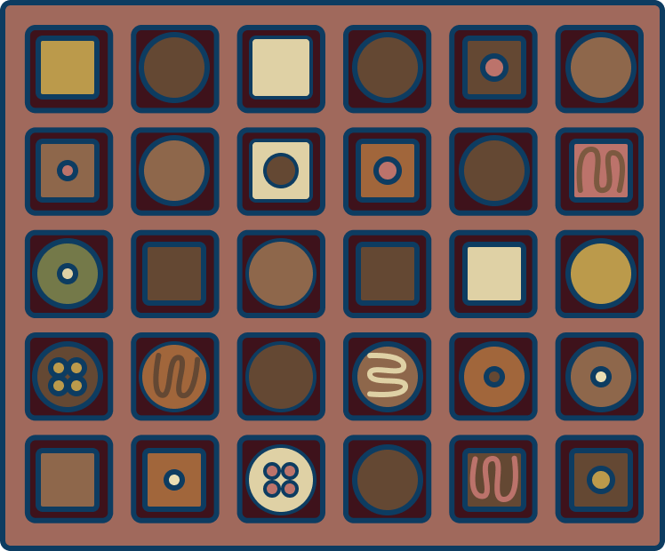
Picture Perfect
Pairs
Focus: Counting in and recognising multiples of 2, 5 and 10.
Aim: Draw a picture that reflects a multiplication calculation of your choice.
Instructions:
Which number fact(s) does this picture show?
In partners, you are going to take it in turns to pick a ‘secret’ multiplication fact from the 2, 5 or 10 times tables.
On your turn, draw a picture that reflects the secret fact you have chosen. Show your partner and see if they can work out what your secret fact was.
If you can’t guess the secret fact, the person who drew the picture has to explain their thinking.
Notes:
Key questions:
How do you identify the fact that has been represented?
Could the picture represent different multiplication facts? How?
Extension:
Can you show your calculation in the form of an array / in groups / in a sequence?

Slide 6
Terrible Twenty-Eight
Whole class
Focus: Rapid recall of multiplication facts for the four times table.
Aim: Predict who will say 28 in each round.
You will need: Mini whiteboards
Instructions:
Stand in a circle with a whiteboard and pen.
Your teacher will pick someone to start. They will say, ‘0 × 4 = 0’.
Continue around the circle saying the next times table fact to 12 × 4 = 48. The count then reverses.
Whoever says 7 × 4 = 28 is out and has to sit down. At this point, everyone predicts who will be out next. Keep a note of how many right answers you get.
There are two ways to win: a) If you are the last person standing. b) If you had the most correct predictions of who will be out.
Notes:
Key questions:
Which fact will you say? Which fact comes next?
Extension:
Change the ‘terrible’ number.
Use division facts instead of multiplication facts.

Slide 7
Four Duel
Pairs
Focus: Rapid recall of multiplication facts for the four times table.
Aim: Be the first to multiply the number on the card by 4.
You will need: A pack of playing cards per pair
Instructions:
An ace is worth 1, a Jack is worth 11, a Queen or King is worth 12.
In pairs, take it in turns to turn over a card. Then race your partner to multiply the number on the card by 4 and place your hand on the card.
Whoever puts their hand on the card first and says the correct answer wins the card. If you say the wrong answer, the card goes to your partner.
Example
First card: 5
Partner B says, “5 × 4 equals 20!” and puts their hand on the card.
Partner B wins the card.
Second card: Queen (12)
Partner A says, “12 × 4 equals 44!” And puts their hand on the card.
Partner A’s answer is wrong so they do not get the card, partner B gets it instead.
Notes:
Key questions:
Remove the joker from the packs before playing.
What strategy can you use to multiply by 4?
How can you find the answer quicker?
Extension:
Try giving two or three four times table facts before claiming the card. (e.g. card shows 2. 2 x 4 = 8, 4 x 2 = 8, 8 ÷ 4 = 2, 8 ÷ 2 = 4)

Slide 8
Bingo, Bingo
Whole class
Focus: Doubling numbers up to 25.
Aim: Be the first to cross off all your numbers.
Instructions:
Write down five different even numbers between 2 and 50
Your teacher will say a number. If, when doubled, the number said matches a number you have, cross it off.
To win, cross off all five of your numbers. When you have crossed off all five numbers, shout ‘bingo, bingo’.
Example
My numbers are 2, 10, 24, 30 and 32.
My teacher says, “12.”
Double 12 is 24.
I cross off 24.
Notes:
Key questions:
Which number was said when you crossed out [number]?
How is doubling linked to times tables?
Extension:
Play the game again but with double, double. (e.g. you say a number between 1 and 13, the pupils double the number and double it again.)

Slide 9
Double Snake
Small groups/ Whole class
Focus: Fluency in doubling numbers.
Aim: Double the initial number given as quickly as you can.
You will need: Mini whiteboards
Instructions:
Your teacher will say a starting number.
Double the number said, write it down and pass the whiteboard to the person behind you. They need to double the new number on the whiteboard and pass it back.
The first team to get to the end of the line with the correct answers written down, wins a point for their team.
Rotate your positions and start again.
Example
My teacher says 2.
I double 2 (4) and pass the whiteboard with 4 written on it to the person behind me.
They write down 8 and pass the whiteboard to the person behind them.
They write down 16 and hold up the whiteboard to show we’re finished.
Notes:
Key questions:
What strategy did you use?
How do you double larger numbers?
Are the different positions in the snake linked to any multiplication facts?
Extension:
Start with larger numbers.

Slide 10
What’s the link?
Small groups
Focus: Investigate and explore links between the 2, 4 and 8 times table.
Aim: Find and explain links between different times tables.
Instructions:
Evie says, “I think my 4 times table is linked to my 8 times table.”
Do you agree? Discuss this in your groups.
Share your thoughts as a class.
Create an image to show how the 2 times tables are linked to the 4 times table and 8 times table.
Notes:
Key questions:
How are the 2 times tables linked?
How does this make it easier to solve the 8 times tables?
Are division facts for the 4 and 8 times tables linked in the same way?
Extension:
Explore the links between other times tables (e.g. 10s and 5s or 10s and 2s.)

Slide 11
Two, Four, Eight, Roll
Pairs
Focus: Recall the 2, 4 and 8 times tables.
Aim: Multiply by 2 then 4 then 8 before the ball reaches you.
You will need: A large space; one football per pair
Instructions:
Sit opposite your partner and take one football.
One of you will say a two times table fact and roll the ball.
The other person has to say the related four times table fact and catch the ball. They then they roll the ball back.
This repeats for the eight times table then back to the two times table. When you get back to the two times table, move closer to each other.
You get a point if your partner makes a mistake or doesn’t respond before the ball reaches them.
Example
Partner A, “2 × 5 equals 10.” (rolls the ball)
Partner B, “4 × 5 equals 20.” (catches ball and rolls it back).
Partner A, “8 × 5 equals 40.” (catches the ball and rolls it back).
Move closer together.
Notes:
Key questions:
Can you complete a full match (i.e. 1 - 12 x 2) without anyone gaining a point?
How are the 2, 4 and 8 times tables linked?
Extension:
Add group points - you score each time you respond quickly / don’t make a mistake but lose a point if you make a mistake/ don’t respond quickly enough.

Slide 12
Threes in the Middle
Whole class
Focus: Recall multiplication and division facts for the 3 times tables.
Aim: Say multiplication and division facts for a multiple of three.
You will need: A medium size area; resource 2
Instructions:
Walk around the space. When your teacher calls ‘MEET’ you need to find a partner.
Look at the number your partner is holding. Think of at least two multiplication or division facts for the number your partner has. They will do the same with the number you have.
When you have both done this, swap cards and find another partner.
Notes:
Key questions:
How many multiplication or division facts can you think of for the number your partner has?
Which numbers are easier to meet? Why?
Extension:
Give all the related facts before you move on.

Slide 13
Three Hold Up
Pairs/ Whole class
Focus: Counting forwards and backwards in and recognising multiples of 3.
Aim: Be the first pair to create an answer and get to six points.
You will need: Resource 3
Instructions:
Your teacher will call out a question related to multiplication or division with the 3 times table.
In your partners, race against the rest of the class to form the answer and hold it up.
The first five pairs to get the answer right gain a point. Be prepared to explain how you found your answer.
The pair to get to six points first wins.
Notes:
Key questions:
How did you find your answer?
How do you know your answer is correct?
Can you show this using an array?
Extension:
Which other facts are related to the given question?

Slide 14
Claim the Threes
Pairs
Focus: Counting forwards and backwards and recognising multiples of 3.
Aim: Say the related division facts.
You will need: A pack of cards each
Instructions:
Deal the cards between you and your partner. The Ace is worth 1, the Jack is worth 11 and the Queen and King are worth 12.
Take it in turns to turn over one card.
Race to say a division fact that is linked to the three times table and place your hand on the card.
The first person to give a correct division fact and put their hand on the card wins.
If someone makes a mistake, the other person gets the card.
Example
A 4 is turned over. Partner A says, “12 divided by 3 equals 4.” and puts their hand on the card, they win the card.
A 6 is turned over. Partner B says, “6 divided by 3 equals 2.” They could have also said 18 divided by 3 equals 6.
Notes:
Key questions:
Which division fact is linked to this number? How do you know?
Is there more than one possible answer?
Extension:
Say all the related three times table facts.

Slide 15
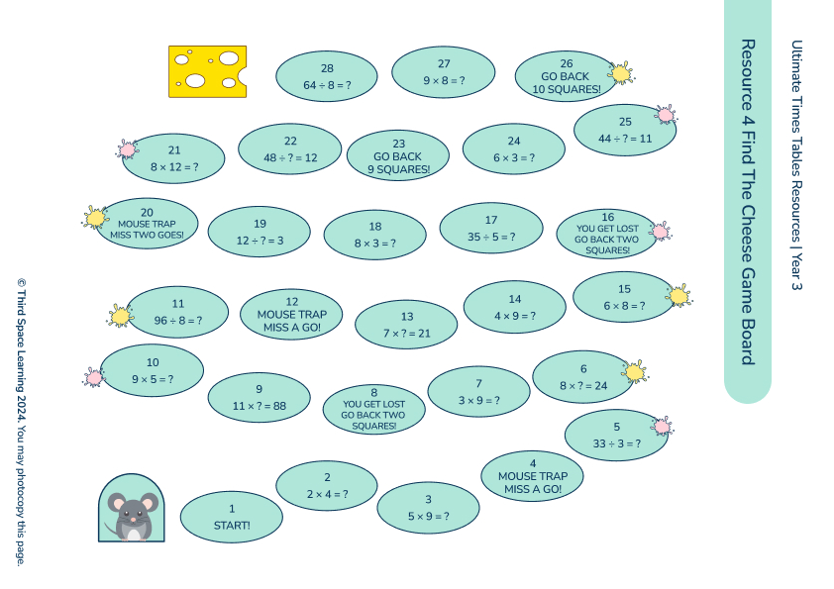
Find the Cheese
Pairs
Focus: The 2, 3, 4, 5, 8 and 10 times tables and the related division facts.
Aim: Get your mouse (counter) to the cheese first.
You will need: Resource 4 per pair; a dice per pair; one counter per pupil
Instructions:
In your partners, take it in turns to roll the dice and move your counter that number of spaces.
Answer the question on the square where you land. If you get the answer wrong, you need to move back to the square you came from.
The winner is the first person to get their ‘mouse’ (counter) to the cheese first. To finish, you must land on the cheese.
Notes:
Key questions:
How can you check your partner’s answers?
Can you draw any pictures to help you?
Are there any other facts linked to the fact you have landed on?
Extension:
Give all the related facts to the fact landed on.

Slide 16
Inverted Bingo
Whole class
Focus: Related division facts for the 2, 3, 4, 5, 8 and 10 times tables.
Aim: Be the first to cross off all your numbers.
You will need: Mini whiteboards
Instructions:
Write five different bingo numbers between 1 and 12.
Your teacher will call out a division calculation linked to the 2, 3, 4, 5, 8 and 10 times tables. If the answer to the calculation is one of your bingo numbers, cross it off.
When all of your numbers have been crossed off, shout ‘bingo’. Your teacher will then check your answers.
Notes:
Key questions:
Vary your language when giving questions e.g. use divided by, groups of
How many questions could I ask that would give you the answer [number]?
Extension:
Play the game in a small group with one of the members being the caller.

Slide 17
Facts on the Wall
Pairs/ Whole class
Focus: Recognise and use multiplication and division facts for the 2, 3, 4, 5, 8 and 10 times tables.
Aim: Answer the questions to get to 15 points first.
You will need: One set of resource 3 per pair; blu tack (or similar); large space
Instructions:
Put blu tack on the back of each of your digit cards.
Stand on one side of the space. Your teacher will call out a multiplication fact for the 2, 3, 4, 5, 8 or 10 times table.
Between you and your partner, you need to create the answer using your digit cards and one at a time run to stick them on the wall opposite you.
Each pair with the correct answer gets a point.
The pair to get to 15 points first wins.
Notes:
Key questions:
Which method will you use to find the answer?
Which facts are easier to remember?
Extension:
Call out division and multiplication facts.

Slide 18
Pop, Bang, Sparkle
Whole class
Focus: Identifying multiples of 3, 4 and 10.
Aim: Don’t say any multiple of 3, 4 or 10.
Instructions:
Count in ones from 0. Each time you are supposed to say a multiple of 3, replace it with ‘pop’.
When you’re confident with this, also replace multiples of 4 with ‘bang’.
If a number is a multiple of 3 and 4 say ‘pop bang’.
Finally, if you say a multiple of 10, say ‘sparkle’ (or pop, bang, sparkle if it’s a multiple of 3, 4 and 10).
Example
0
1
2
POP
BANG
5
POP
7
BANG
Notes:
Key questions:
What do you notice about the numbers being replaced?
Are there more pops or bangs?
Would we ever say pop, bang, sparkle?
Extension:
Change the multiples that you replace with pop, bang, sparkle.

Slide 19
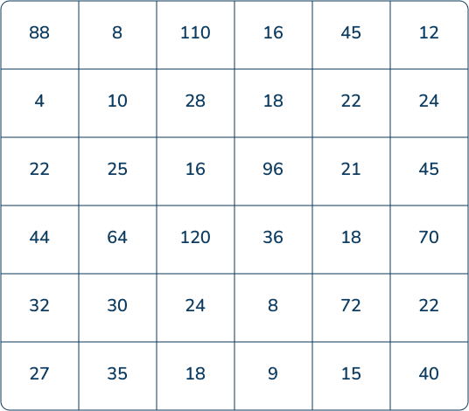
Squares
Pairs
Focus: Recognise and use multiplication and division facts for the 2, 3, 4, 5, 8 and 10 times tables.
Aim: Place your counters so that they form the vertices of a square (of any size).
You will need: Resource 5; counters
Instructions:
Each pair will need a copy of the squares resource and two sets of coloured counters.
Take it in turns to place a counter. To place a counter, you must point to the number on the sheet and say a multiplication fact that gives this answer (you cannot use the one times table).
You win when you have placed four counters so they form the vertices of a square.
Notes:
Key questions:
Can you explain your strategy?
Which square was the easiest to secure?
Extension:
Make your own large game board that incorporates more times tables.

