Slide 1
Year 1

Slide 2
Overview
Activity | Individual activity | Pairs activity | Small group activity | Whole class activity | Resources needed
1) Up the Stairs | x | x |  |  | Linking cubes
2) In the Two’s Band |  |  | x | x | 1 musical instrument per pupil Resource 1
3) Race in Two |  | x |  |  | Resource 1 per pupil
4) At the Zoo in Two | x
5) The Sound of 2s |  |  | x | x | A tin/ metal container Marbles/ counters/ coins Mini whiteboards
6) Three Fives |  | x |  |  | Resource 2 per pair 10 counter of one colour per pupil
7) Make the Fives |  |  |  | x | Large number of items (e.g. cubes/ counters)
8) Fives Tennis |  | x

Slide 3
Overview
Activity | Individual activity | Pairs activity | Small group activity | Whole class activity | Resources needed
9) 5s Blast Off |  |  | x | x
10) Hoop the Fives |  |  | x | x | Hoops Large area Resource 3 per team
11) Sticks |  |  | x |  | Link cubes
12) Fives in the Forest | x |  |  |  | Resource 4 per pupil
13) Mean 90 |  |  | x | x | Mini whiteboards
14) Speedy Tens |  | x |  |  | Resource 3 per pair
15) 2s, 5s and 10s Out and About |  | x | x |  | (If available) camera
16) Group It |  |  | x |  | An area

Slide 4
Up the Stairs
Individual/ Pairs
Focus: Counting in multiples of 2.
Aim: Make a staircase using multiples of 2.
You will need: Linking cubes
Instructions:
Make the staircase shown using 2 cubes, then 4 cubes then 6 cubes.
Carry on building the staircase. Can you say the multiples of two shown by the staircase?
Notes:
Key questions:
What do you notice about the stairs?
Which numbers are represented?
How many cubes will be in the next step?
How many cubes were in the previous step?
Extension:
Label each step with the multiples of 2.

Slide 5
In the Two’s Band
Small group/ Whole class
Focus: Counting in and recognising multiples of 2.
Aim: Make music while counting in twos.
You will need: One musical instrument each, resource 1
Instructions:
We are going to count together in multiples of 2 from 0 to 20.
Take one musical instrument and one card each.
We are going to count in multiples of 2 again. This time when we count, if we say your number, play your musical instrument instead.
Example
I have the number 6.
We all say:
0, 2, 4, I play my instrument instead of saying 6, 8, 10
Notes:
Key questions:
Which number is before / after your number?
What do you notice about the ones digits we are saying?
If I had the number 7, would I get to play my instrument? Why / why not?
Extension:
Play with a different multiple.

Slide 6
Race in Two
Pairs
Focus: Counting in and recognising multiples of 2.
Aim: Get the most cards.
You will need: One set of resource 1 per pair
Instructions:
Your teacher will put you into pairs and give you one set of cards.
Take it in turns to turn over a card.
Count in twos from 0 until you reach the number on the card - the person who reaches the target number first wins the card.
Keep playing until all the cards have been won. Whoever has the most cards wins.
Notes:
Key questions:
Which numbers will you say? Which will you not say?
What does counting in twos mean?
Extension:
Play with numbers above 20.

Slide 7
At the Zoo in Two
Individual
Focus: Counting in and recognising multiples of 2.
Aim: Find out how many kangaroos each person has seen.
Instructions:
Can you work out how many kangaroos each child has seen?
Kian counts eight legs in the kangaroo area.
Hope counts 12 legs.
Aina counts 20 legs.
Notes:
Key questions:
Tell the pupils that kangaroos have 2 legs
How can you calculate how many kangaroos each pupil saw?
Could someone have seen seven legs?
Extension:
Show the pupils a multiple of two - how quickly can they work out how many kangaroos there are?

Slide 8
The Sound of 2s
Small group/ Whole class
Focus: Counting in and recognising multiples of 2.
Aim: Count the total number of points your teacher adds to the tin.
You will need: Tin or a metal container; marbles, counters or coins; mini whiteboards
Instructions:
Close your eyes.
Whenever you hear an item dropping into the tin, it is worth two points.
Listen carefully and count the total points.
When you are told to, open your eyes and write on your whiteboards the number of points that were added to the tin.
Notes:
Key questions:
How can you work out how many points there are?
What do you notice about the ones when counting in twos?
What is one more / one less than the number of points there are?
Extension:
Take turns to be the person dropping items into the tin. (Make small groups and pupils can take it in turns to drop items into a tin.)

Slide 9
Three Fives
Pairs
Focus: Counting in and recognising multiples of 5.
Aim: Put three of your counters in a row on the grid.
You will need: One copy of resource 2 per pair; 10 counters of one colour each
Instructions:
To place a counter, point to a number on the sheet and count to the number in fives out loud.
If you count correctly, you get to place your counter.
If your partner spots a mistake in your counting, you cannot place a counter.
Take it in turns to try to place a counter until one of you has three in a row.
Notes:
Key questions:
How do you know your partner has counted correctly?
Can you spot a pattern when we count in fives?
How many times have you counted in five to get to [number]?
Extension:
Say how many groups of five make each number on the grid. (Ask pupils to do this without counting up.)

Slide 10
Make the Fives
Whole Class
Focus: Counting in and recognising multiples of 5.
Aim: Make the number said using groups of five.
You will need: Large number of items e.g. cubes or counters
Instructions:
Your teacher will call out a multiple of 5.
In pairs, you then need to race against the rest of the class to make the number out of your resources in groups of five.
As a class, count in fives until you get to the number, how many groups of five have you made?
Notes:
Key questions:
How many groups of five will you need to make?
How do you know if a number can be made from groups of five?
Which number could you not make from groups of five?
What is one more/ less group of five than your number?
Extension:
Once you have played the game a few times, take it in turns to be the ‘caller’ and check each other’s answers.

Slide 11
Fives Tennis
Pairs
Focus: Counting in and recognising multiples of 5.
Aim: Be the first person to say 50.
Instructions:
In pairs, you are going to play tennis using multiples of five instead of a ball.
One person will start by saying 0, the next person will say the next multiple of 5. Take it in turns until you reach 50 without mistakes.
If you make a mistake you’re out and your partner wins this round.
Whoever says 50 first wins.
Example
A: 0, B: 5, A: 10, B: 15, A: 20, B: 25, A: 30, B: 35, A: 40, B: 45, A: 50
A wins this round.
A: 0, B: 5, A: 11
B wins this round.
Notes:
Key questions:
How do you know your partner has counted correctly?
Can you spot a pattern when we count in fives?
How many times have you counted in five to get to [number]?
Extension:
Pick a different number to be the goal number instead of 50.
Play tennis with another multiple, for example with multiples of 10.

Slide 12
5s Blast Off
Small groups/ Whole class
Focus: Counting in and recognising multiples of 5.
Aim: As a group count in multiples of five from 0 to 50.
Instructions:
Sit in a circle so you can see everyone in your group.
You are going to count from 0 to 50 in multiples of 5 in your group.
Only one person can say a number at a time. If two people talk at the same time (or you make a mistake), you need to start counting again from 5.
Example
A: 0
B: 5
C and D: 10
The group need to start again.
Notes:
Key questions:
Which multiple of five comes next?
Extension:
Explain your strategy for counting from 0 to 50 in the quickest time (with no mistakes).

Slide 13
Hoop the Fives
Small groups/ Whole class
Focus: Counting in and recognising multiples of 5.
Aim: Use the digit cards to show how many multiples of five your teacher has said.
You will need: Hoops; large area; resource 3 per team
Instructions:
Your teacher will call out a number. As a team, you need to count that number of fives.
When you have the answer, you need to use your digit cards to show the number. You need to put the digit cards in your hoop. You can only take one digit card to the hoop at a time.
The team who creates the number in the hoop first, gets a point.
Example
The teacher says 4.
4 lots of 5 is equal to 20.
The team need to take the digit 2 and the digit 0 to the hoop.
A runs to the hoop with 2 and runs back.
B runs to the hoop with 0 and runs back.
Notes:
Key questions:
Which strategy could you use to find the answer?
Can you find a quicker way to find the answer?
Extension:
Show in the hoop how many fives are in [multiple of five].

Slide 14
Sticks
Small Groups
Focus: Counting in and recognising multiples of 2 and 5.
Aim: Make the number given using sticks of 2 or 5.
You will need: Link cubes (40 cubes in one colour and 50 cubes in another colour per group)
Instructions:
Make 20 sticks of two cubes and 10 sticks of five cubes. If you can, make the sticks of two in one colour and the sticks of five in another colour.
Your teacher will call out a multiple of 2 or 5.
Show the number said using the sticks of two or the sticks of five.
Example
The teacher says 10.
One pair use 5 sets of the two sticks.
Another pair use 2 sets of the five sticks.
Notes:
Key questions:
Gather lots of link cubes and share them between pupils. Pupils can be in partners or small groups.
What do you notice about a number that is a multiple of 2 and 5? Which number can be made using sticks of 2 or 5?
Which number can we not make out of sticks of 2 / sticks of 5?
Extension:
Predict how many sticks of 2 or 5 you will need to make [number].

Slide 15
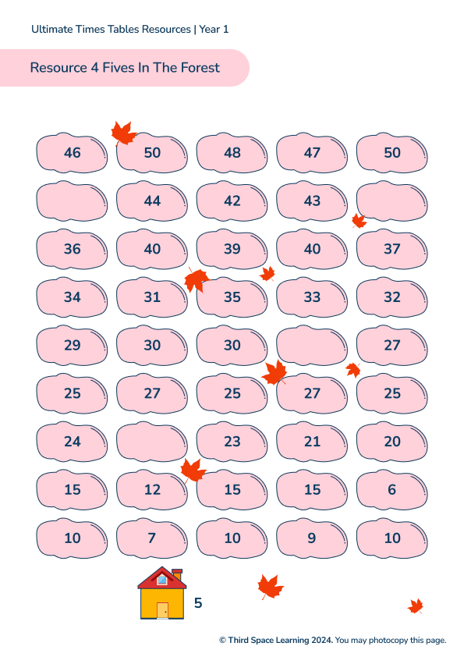
Fives in the Forest
Individual
Focus: Counting in and recognising multiples of 5.
Aim: Follow the stepping stones through the forest by counting in multiples of 5.
You will need: Resource 4 each
Instructions:
Your challenge is to get from the hut in the forest to the edge of the forest by only stepping on multiples of 5 in order.
You can step on any stone next to the one you are on. If there is a blank stone, you can write a number on it.
Notes:
Key questions:
Which number have you started on?
Which number comes next?
Which stones can you not step on?
Extension:
Find another route through the forest.
Pupils can create their own game using a blank grid for others to play.

Slide 16
Mean 90
Small group/ Whole class
Focus: Counting in and recognising multiples of 10.
Aim: Predict who will say the ‘mean 90’ in each round.
You will need: Mini whiteboards
Instructions:
The whole class (and teacher) needs to stand in a circle with a whiteboard and pen.
Your teacher will start by saying 0. Going round the circle, count in multiples of 10 to 100.
Whoever has to say 90 has the ‘mean 90’ and must sit down. Everyone must predict who will be the next person to sit down and write this on their whiteboard. Keep a note of how many right answers you get.
The next person says 100 then the group starts counting again from 0.
There are two ways to win: a) If you are the last person standing. b) If you had the most correct predictions of who will be out.
Notes:
Key questions:
Which number do you have to say? What do you notice about multiples of 10?
How can you guess who will be out next?
Extension:
Change the ‘mean’ number to a different multiple of 10.

Slide 17
Speedy Tens
Pairs
Focus: Counting in and recognising multiples of 10.
Aim: Say the correct answer first to win the most cards.
You will need: Resource 3 per pair
Instructions:
In partners, take it in turns to turn over a digit card.
What is ten lots of the number you have turned over?
Whoever says the correct answer first wins the card.
Whoever has the most cards at the end wins.
Notes:
Key questions:
How can you calculate the answer?
What pattern do you notice with multiples of 10?
Extension:
Make cards with multiples of 10 on them, turn over the cards and say how many groups of 10 make the number on the card.

Slide 18
2s, 5s and 10s Out and About
Pairs/ Small groups
Focus: Counting in and recognising multiples of 2, 5 and 10.
Aim: Find groups of 2, 5 and 10 around the school.
You will need: If available, a camera per group.
Instructions:
In groups, explore the school to spot things arranged in groups of 2, 5 or 10.
If you have a camera, photo what you have spotted. Also, make a note of how many groups of each number you find.
Notes:
Key questions:
Is it easier to find groups of 2, 5 or 10?
Why is it quicker to count in groups instead of ones?
Extension:
Add further conditions. For example, in one photo, can you show two groups of two?

Slide 19
Group It
Small groups
Focus: Counting in and recognising multiples of 2, 5 and 10.
Aim: Find what your teacher describes.
You will need: An area to explore (ideally outside).
Instructions:
Your teacher will tell you to find a certain number of items and then tell you to put them into groups of 2, 5 or 10.
Whichever team finds an example of what the teacher has said first wins a point.
Example
The teacher says, “Find 10 sticks and put them into groups of 5.”
Whoever finds the ten sticks and arranges them into groups of five first wins a point.
Notes:
Key questions:
How many items did you find in total?
How can you group them to make them easier to count?
Extension:
Tell pupils to find a number of items and organise them into groups (e.g. find 40 stones and put them into groups of 10).

