Slide 1

Welcome to the Maths Parent Forum
Have a go:
Use 2 straight lines to split the clock face so that each part totals 26.

Slide 2
A mastery approach to maths
The mastery approach to mathematics was introduced in 2015 when changes were made to the National Curriculum.
To enable us to develop and embed a consistent mastery approach to teaching we joined the Midlands Maths Hub in 2019
The Maths Hub Programme is co-ordinated by the National Centre for Excellence in the Teaching of Mathematics (NCETM)
We are now entering the second year of a three year mastery programme.
Year 1 – Introducing a mastery approach
Year 2 – Developing a mastery approach
Year 3 – Embedding a mastery approach.

Slide 3
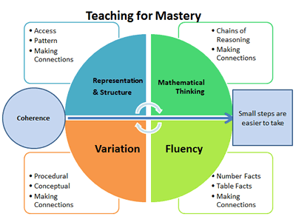
What is mastery?

Slide 4
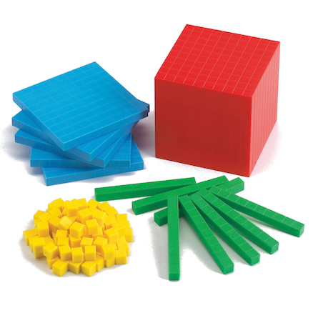

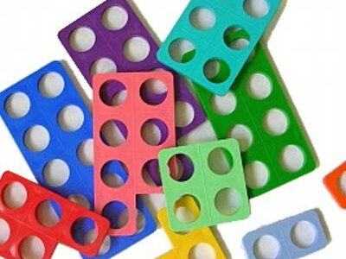

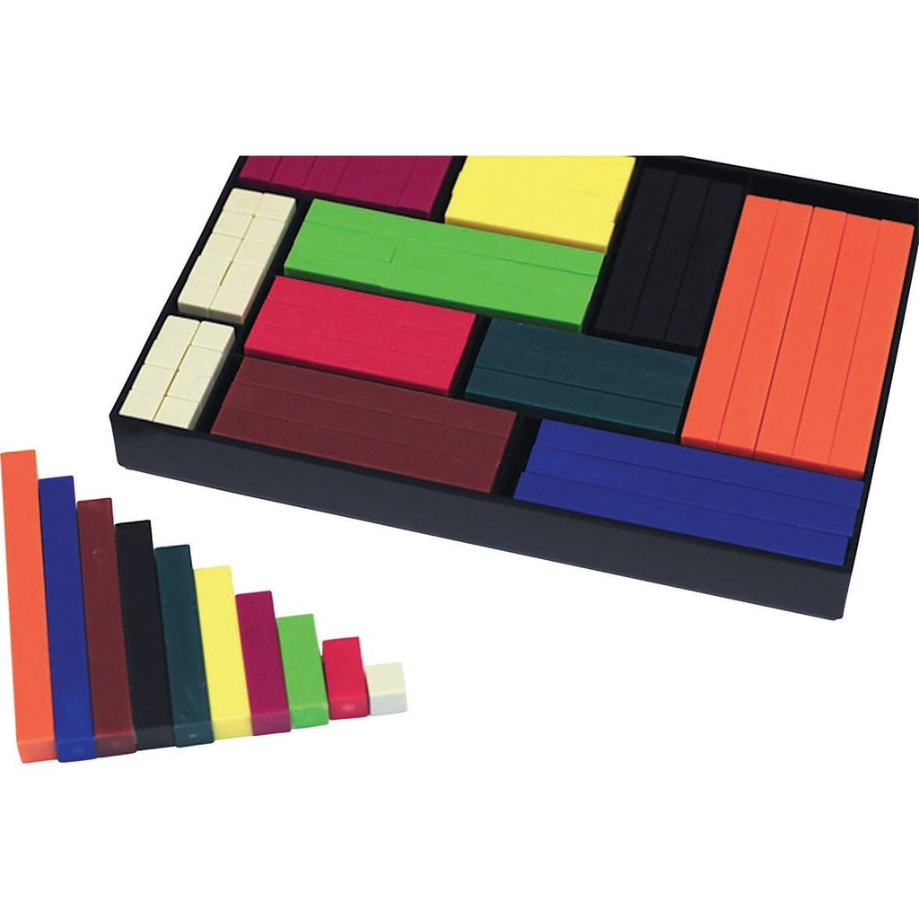
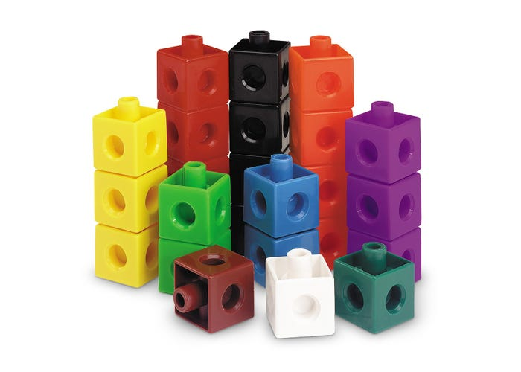

Representations and Structures
Use of manipulatives to support learning
Bead strings
Diennes
Numicon
Place Value Counters
Cuisenaire rods
Interlocking Cubes

Slide 5
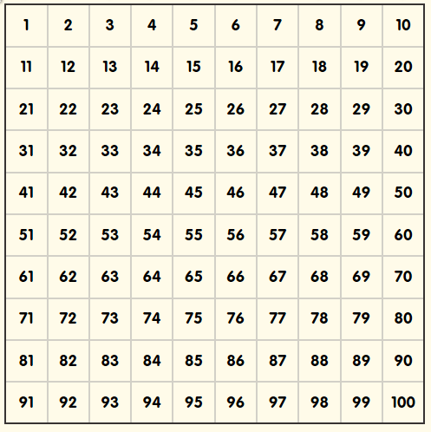
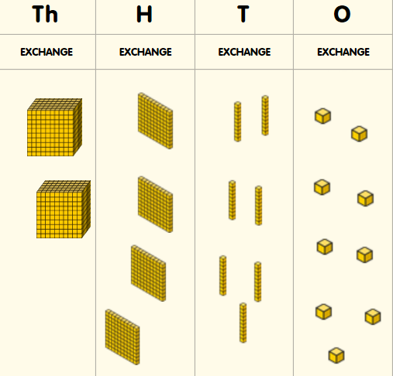
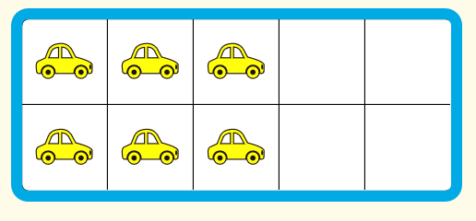
Representations and Structures
Use of visual images to support learning and make connections.
Number Square
Tens Frame
Place Value Grid
Number Line

Slide 6
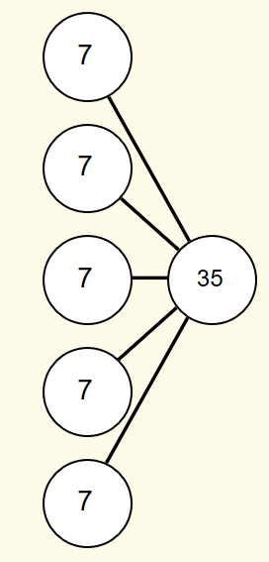
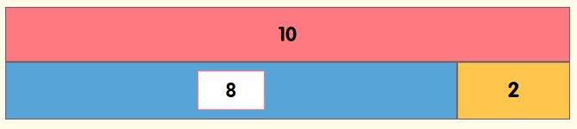
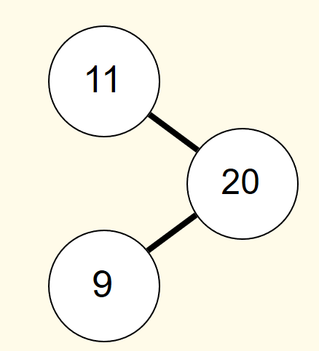

Representations and Structures
Use of visual images to support learning and make connections.
Bar Model
Array
Part Whole Model

Slide 7
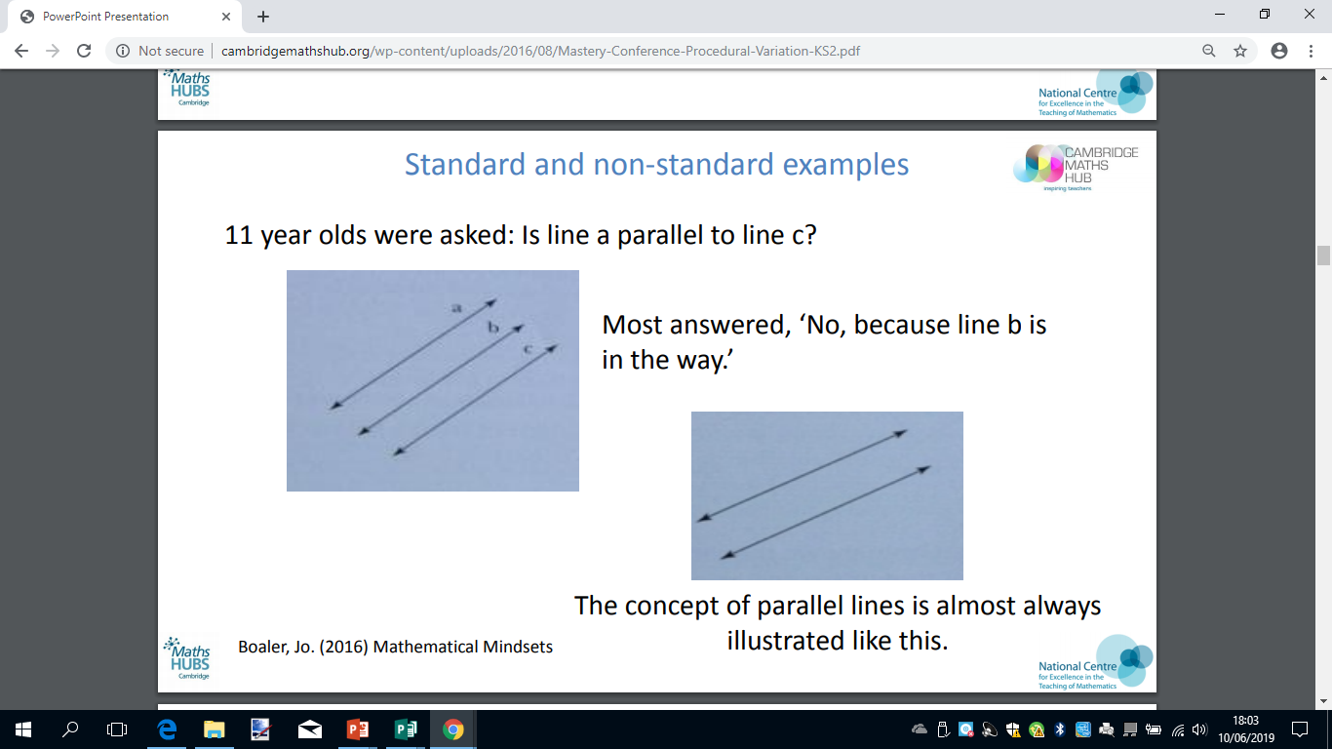
Conceptual Variation

Slide 8
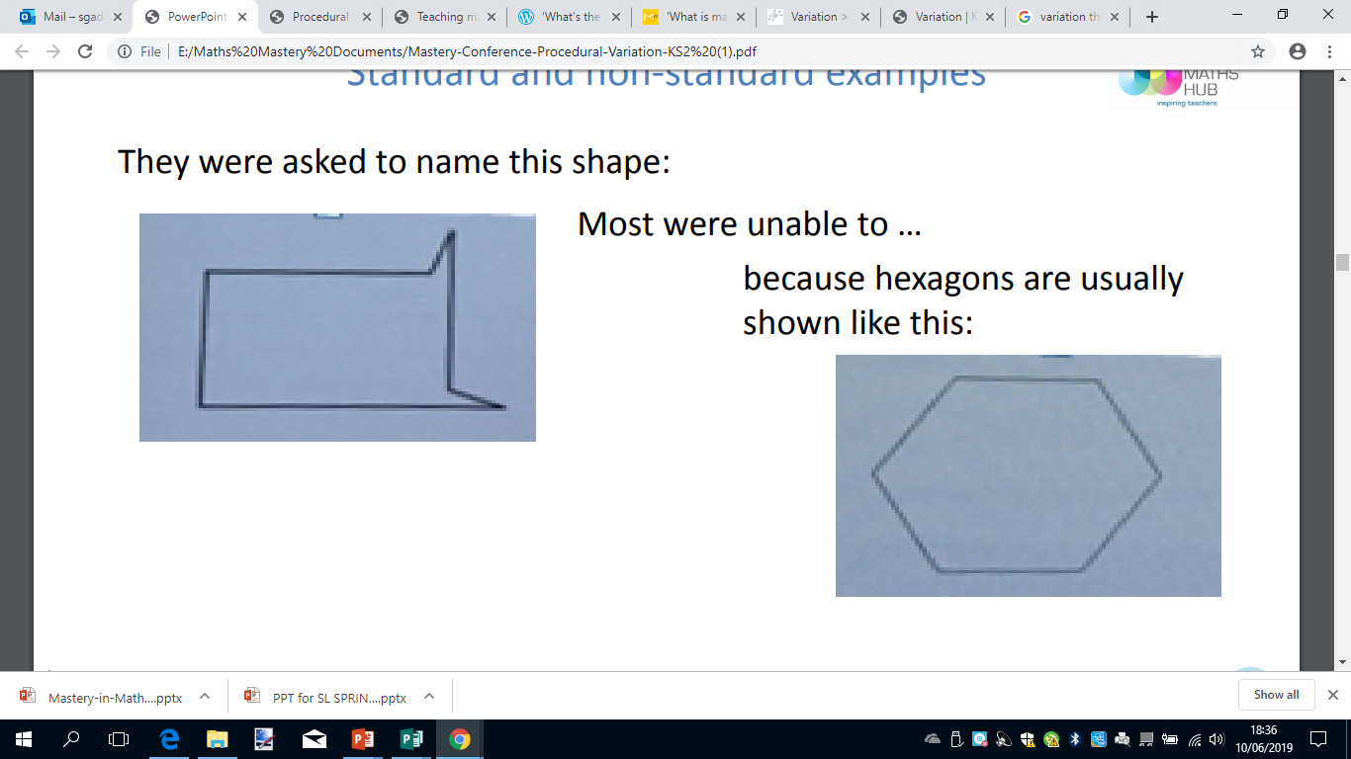
Conceptual Variation

Slide 9

Conceptual Variation
Examples and ‘non-examples’
  …what is the same and what is different…?

Slide 10




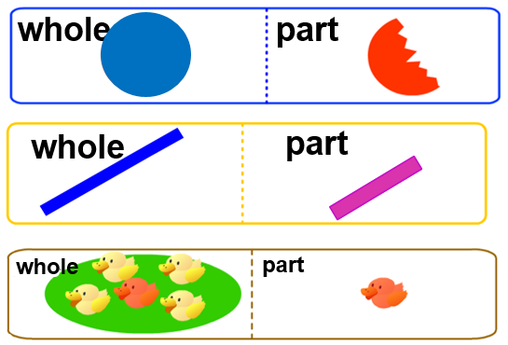

Conceptual Variation

Slide 11
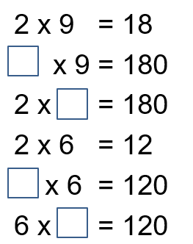
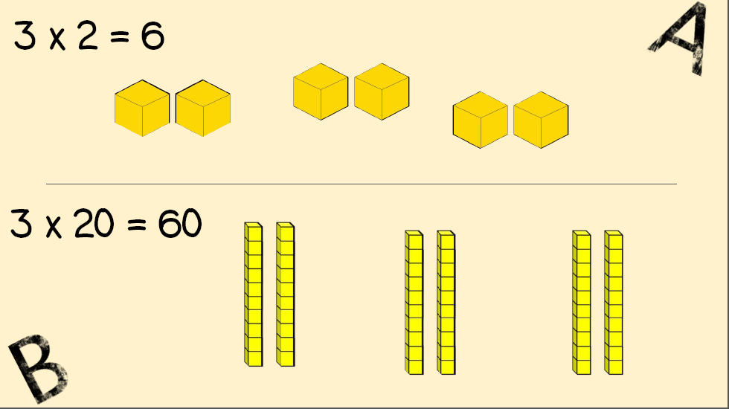
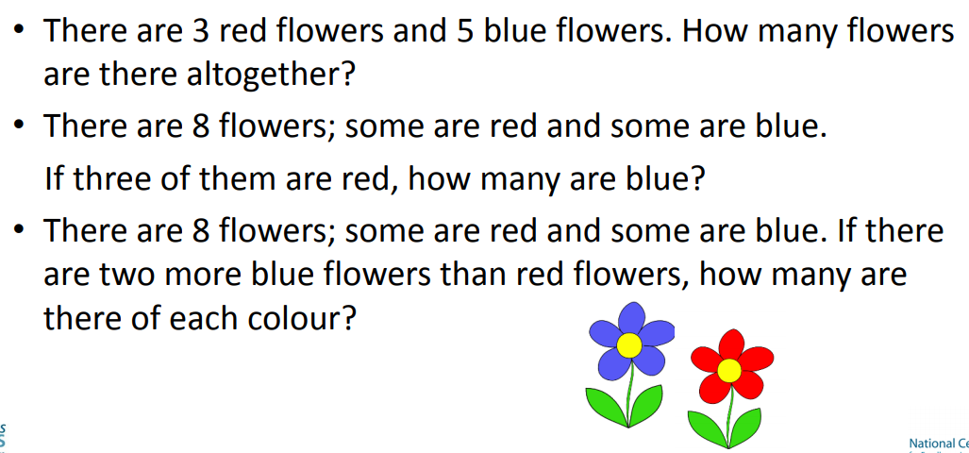
Procedural Variation

Slide 12
Episodic lesson
Includes all children
Short tasks, continual assessment by teachers
Mix of individual / pair /group tasks
Time for discussion
Small steps of understanding to keep class together; skilful questioning to extend pupils who are quick to grasp concepts.
Support for children to keep up
Increasing cognitive demand
Challenge for all through reasoning.

Slide 13

A0100

Slide 14




At the heart of
Power Maths
is the belief that all children can achieve.
It’s built on an exciting growth mindset and
problem-solving approach.
Notes:
Power Maths is an interactive, whole-class teaching model.
It encourages precise mathematical language and allows children to deepen their understanding as far as they can.
By working hard, all children can achieve.

Slide 15

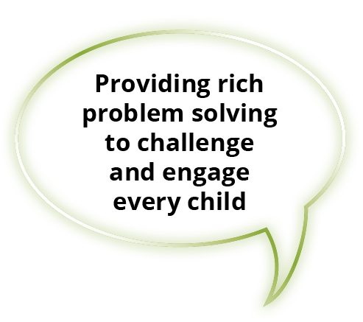
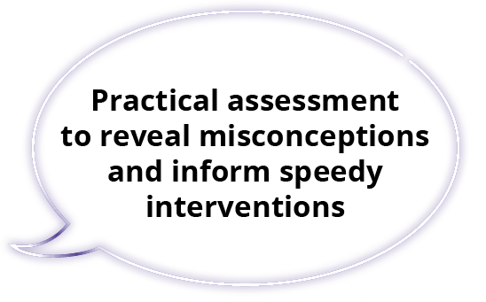

Key aims of Power Maths
Notes:
Builds every concept in small, progressive steps to help keep the whole class together.
Helps children problem-solve by building on prior learning to help them see connections and patterns.
Teachers can check understanding throughout the lesson to ensure all children are keeping up.
Power Maths aims to spark curiosity and encourages rich mathematical talk.

Slide 16
Growth mindset
Fixed mindset
Growth mindset
“I’m not good at maths – I’ve never been good at maths”
“I’m finding maths hard now, but I can improve with time and effort”
“I give up – I can’t make this any better”
“I can improve if I keep trying”
“If I fail I am a failure”
“Most successful people fail along
the way”
“I can’t do this – I keep making mistakes”
“Mistakes help me learn”
Notes:
The growth mindset approach encourages children to see mistakes as learning opportunities. It promotes hard work and practice, and discourages the idea that some people ‘can’t do maths’.

Slide 17



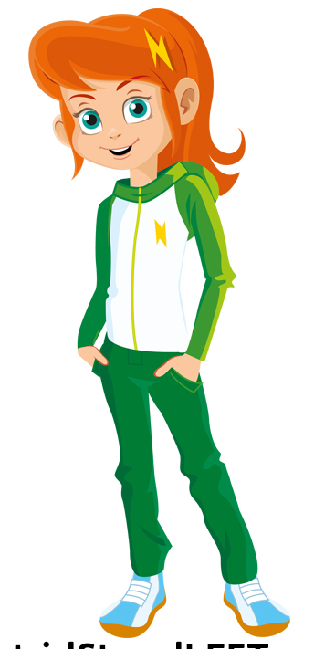
Power Maths growth mind set characters
Ash
Ash is curious and inquisitive. He loves to explore new concepts
Flo
Flo is flexible and creative. She often with new methods to solve problems.
Astrid
Astrid is brave and confident. She is not afraid to make mistakes.
Let’s try again!
Can we do it differently?
I will share my ideas!
Dexter
Dexter is determined. When he makes a mistake he learns from it and tries again.
Is there a pattern?
Notes:
The growth mindset characters help build mathematical confidence so every child can reach their potential.
They are allies for our children and are all hard-working, enthusiastic and unafraid of making mistakes!

Slide 18
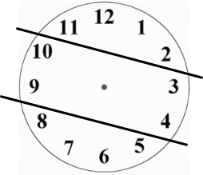
Solution
Which growth mind set attributes did you use when solving the problem?
Flexibility
Determination
Curiosity

Slide 19


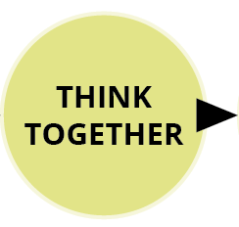
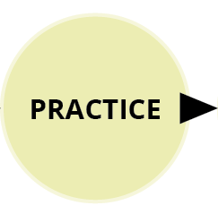


See the lesson structure
Notes:
A consistent structure for delivering a whole-class mastery approach in which no child is left behind. Each lesson follows the same format. Same-day interventions help us keep the class progressing together, so Power Maths provides plenty of support throughout the journey.

Slide 20
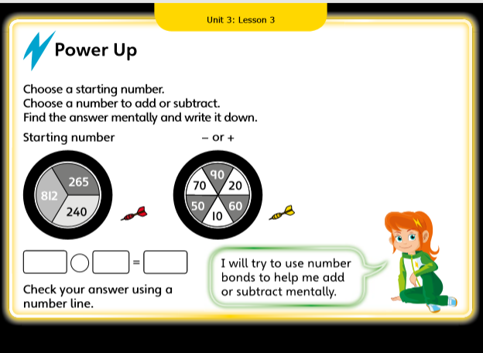

Slide 21
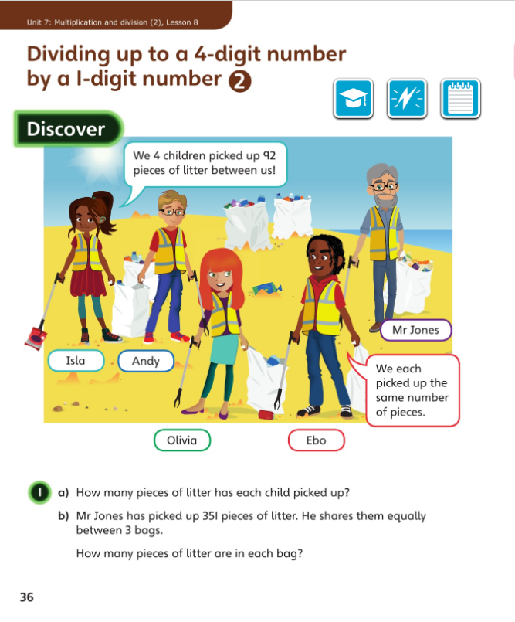
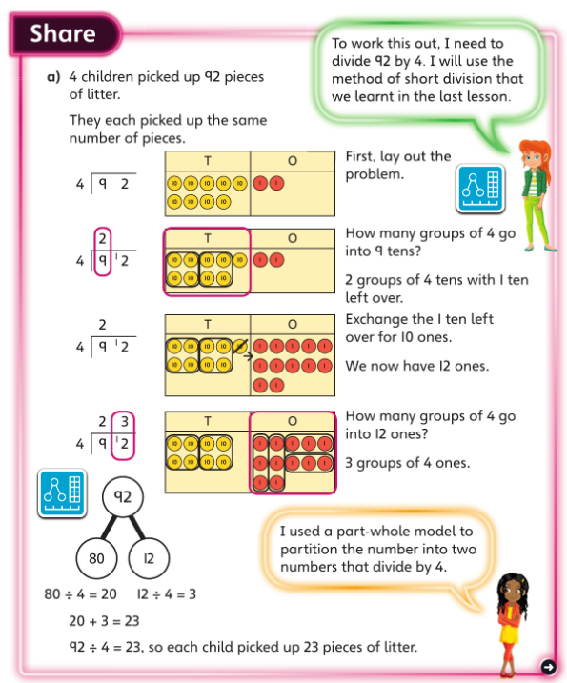
Discover and Share
Concrete-Pictorial-Abstract approach
Engaging scenarios
Notes:
In Discover, appealing real-life scenarios stimulate curiosity, helping children to identify the maths problem and discover patterns and relationships for themselves.
The concept is introduced logically using a Concrete-Pictorial-Abstract approach to help children to make connections and grasp concepts.
Here in Share part a), children are shown the pictorial representation of place value counters alongside the more abstract method of short division. The Power Maths characters provide support and help children to develop a growth mindset by encouraging them to think, reason and reflect.

Slide 22
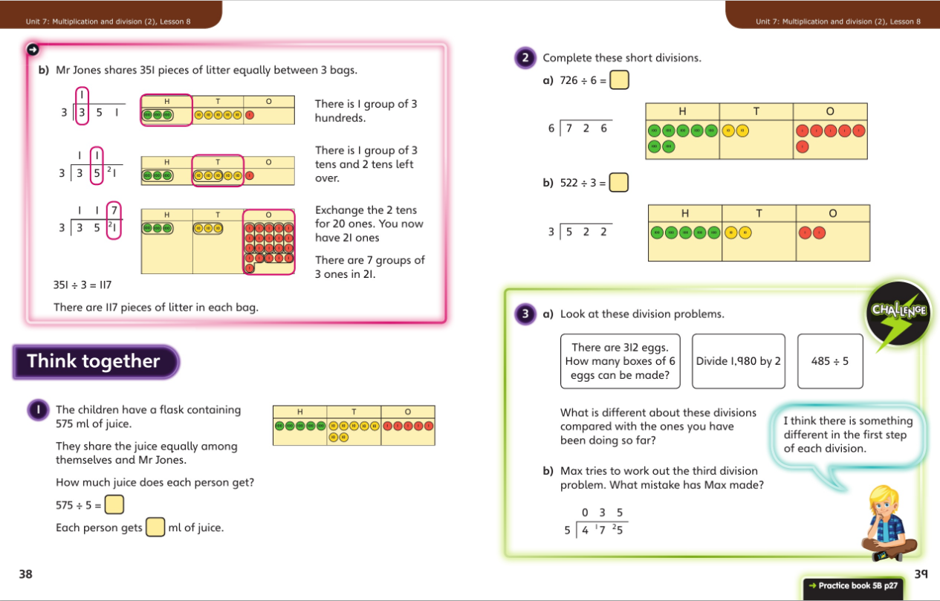
Think together
Friendly, supportive characters help children develop a growth mindset.
Notes:
In Think together, the scaffolding is gradually reduced as children become more familiar with the mathematical concept. We encourage children to talk together to explain how they solve the problems.
Throughout, maths language is used consistently to encourage all children to use the correct terms and feel comfortable with them.

Slide 23
Questions are presented in a logical sequence.
Practice
Calculations are connected so that children think about the underlying concepts.
Notes:
This is continued in the Practice Books, where each question varies one small element to move children on in their thinking.
Children complete intelligent practice independently, ending in a Reflect section where children reveal the depth of their understanding before moving on.

Slide 24
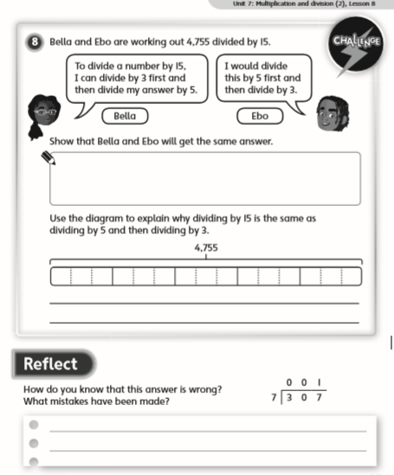

Slide 25
Supporting pupils
Same day interventions to enable pupils to keep up not catch up.
TA led interventions
First Class @ Number: Year 1 led by Mrs Smallman
First Class @ Number 2: Year 2 & 3 led by Mrs Whittlestone.
Success@ Arithmetic: Years 5 & 6 led by Mrs Nicholls
‘Plus 1 and Power of 2’ – 1:1 catch up programmes.
Find out more by clicking on the links below:
https://everychildcounts.edgehill.ac.uk/mathematics/1stclassnumber/
https://everychildcounts.edgehill.ac.uk/mathematics/successarithmetic/
https://www.123learning.co.uk/maths-support-book-plus-1/
https://www.123learning.co.uk/maths-support-book-power-of-2/

Slide 26
Developing Higher Cognitive thinking
  A child really understands a mathematical concept, idea or technique if he or she can:
  Explain it
  Draw it /represent it (e.g. using concrete materials, pictures and symbols – the CPA approach)
  Make up own examples (and non-examples)
  Write their own question
  Prove it
  See connections between it and other facts or ideas
  recognise it in new situations and contexts.

Slide 27
Find out more about mastery
https://www.ncetm.org.uk/teaching-for-mastery/mastery-explained/
Mastery and more able pupils
https://www.stem.org.uk/news-and-views/opinions/how-does-mastery-approach-help-progress-mathematics

